Slide 1
BMS Curriculum Night 2019

Slide 2
General Information
Students will report to the gym or cafeteria when they arrive for school.
1st period begins at 7:30. If students are not in their 1st period teacher’s classroom by the 7:30 bell, they will be counted tardy.

Slide 3
Agendas
The student agendas are used for
Helping students stay organized
Hall passes
Parent communication
Organizational Marks
Behavior Marks
Please check agendas every day.

Slide 4
Schedule
7:30-8:43 First Period
8:45-9:10 Flex
9:13-10:23 2nd Period
Locker Break
10:28-12:14 Third Period & Lunch
12:17-1:25 Fourth Period
Locker Break
1:30-2:40 Connections
2:40 Dismissal

Slide 5
Class Interruptions
In order to maximize classroom instruction, the office is minimizing classroom interruptions.
Students will not be called to the office to pick up lunches, books, projects, etc.

Slide 6
Organizational Marks
OM’s will be given for minor infractions like late paperwork, being unprepared for class, returning to their locker, and not having homework completed.
After you receive 5 OM’s, we will call home, and your child will have silent lunch.

Slide 7
Organizational Marks
After 10 OM’s, we will call home, and your child will have grade level detention. He or she will lose the Grade Level reward (Kickball or Dodgeball tournament, movie, etc.). If your child receives an 11th OM, he/she will receive an office referral.
Students will receive a new OM sheet for Q1 and Q2; however, they will only receive 1 sheet for Q3 and Q4 combined.

Slide 8
Behavior Marks
Any behavior that disrupts the learning environment of other students (ex. dress code infractions, not following directions, gum, inappropriate language, etc.) or prevents the teacher from continuing the lesson will result in consequences for the student on the grade level behavior marks sheet. This will be recorded for the entire school year.
Steps:
Step 1-Written Warning
Step 2-Parent Contact & Silent Lunch
Step 3-Parent Contact & 2 Silent Lunches
Step 4-Parent Contact & Grade Level Detention
Step 5-Parent Contact, Office Referral, & Isolation

Slide 9
Late Work Policy
Ten points per day will be deducted for late assignments for up to two days. Late assignments will not be accepted after the second day.
Math homework assignments will NOT be accepted past the due date. Because the daily lessons build on previous lessons, math homework must be completed each night.

Slide 10
Late Work Policy
Absent?
Check a friend’s agenda or the teachers’ posted agenda
It is your child’s responsibility to make up missed work
No Extra Credit
– do your assigned work on time!
Do your best the first time!

Slide 11
BMS Technology Policy
Devices should be turned off and placed in lockers for the entirety of the day unless directed by the teacher for a specific period.
Cell phones, music devices, cameras, and other communication devices shall not be seen, used, or heard during school hours unless directed by the teacher.
Students may not have their phones out after school until they are in the car or on the bus (with the driver’s permission).

Slide 12
BMS Technology Policy
All devices should be used for instructional purposes only.
Students in violation of this expectation will have their device collected and stored in the main office for parent pickup.
Violators will receive disciplinary consequences.
The school is not responsible for any lost, damaged, or stolen communication device.

Slide 13
Standardized Dress Code
Look for detailed information in the back of the student agenda (blue page).
Friday spirit wear is a privilege and not a guarantee. It is earned if a student has no absences, no tardies, no check outs, and is in dress code every day that week.
Please note that pink is not a dress code color. The color pink with a Buford insignia or logo is only appropriate on Fridays if a student has earned spirit wear for that week.

Slide 14
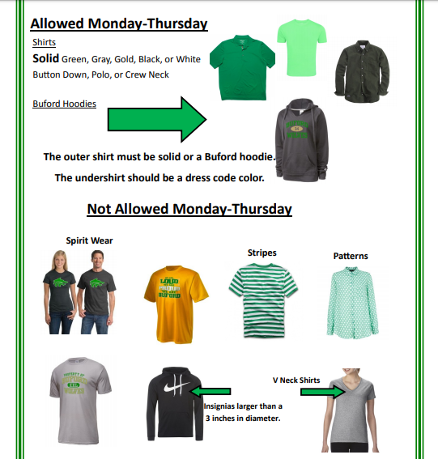
Standardized Dress Code (Cont.)

Slide 15
Attendance and Dress Code
Students will receive a on the monthly calendar in their agenda for:
Tardies
Check outs
Absences
Dress code infractions
It is the student’s responsibility to check their agenda to see if they have earned spirit wear for the week.

Slide 16
7th Grade Newsletter
Our newsletter is now located on the BMS website.
Click on “BMS Teams” and then select the website for 7th grade. The newsletter will be the first item listed on the webpage.
Note: it will not be emailed weekly.
The newsletter will provide important grade level news, upcoming dates, and specific subject area information.
All 7th grade teachers’ websites are linked on this webpage.

Slide 17
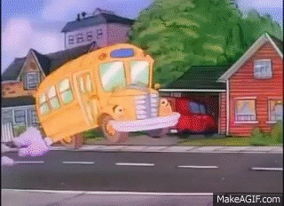
7th Grade Field Trips

Slide 18
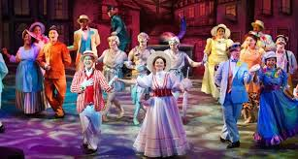
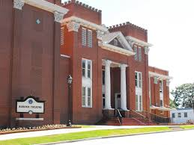
Fall Field Trip
Students are going to see a play at The Aurora Theater in Lawrenceville on either October 9th & 10th. Permission slips will be sent home soon.
We will eat lunch at the Mall of Georgia food court on the way back. Students will need $5-$10 to purchase their lunch.
They may bring a sack lunch or order a school lunch if needed.

Slide 19
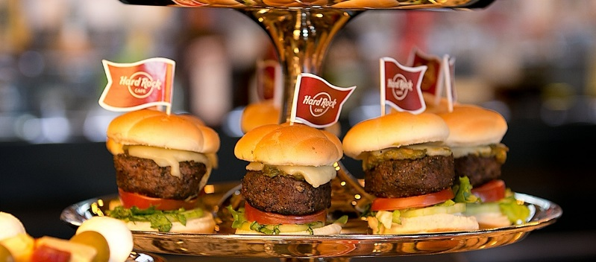
Spring Field Trip
April 28th at Zoo Atlanta & Hard Rock Café
We will travel in charter buses.
We need parent chaperones.
Must have a background check on file with BCSS
Information will be sent as soon as details are finalized.

Slide 20
Discipline & Attendance Requirements for Field Trips
Although field trips are optional, we would like for every student to attend.
Students who have had discipline (suspension) or attendance problems (15 or more days absent) will not be eligible.
Refer to page 10 in the student agenda for more information.

Slide 21
Important Dates
August 30th — Early Release & Color Run fundraiser
September 2nd —Labor Day holiday
September 5th — Picture Day
September 20th — Early Release & Homecoming
October 11th & 14th - Student Holiday
October 15th, 17th, & 18th – ITBS

Slide 22
THANK YOU so much for attending Curriculum Night!

