Slide 1
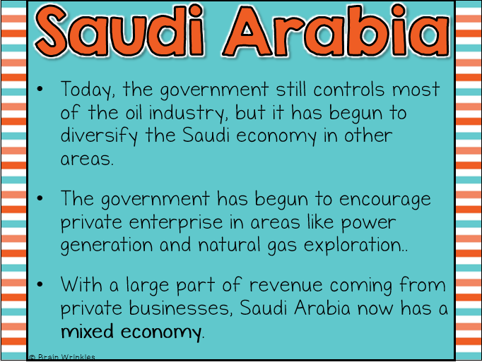
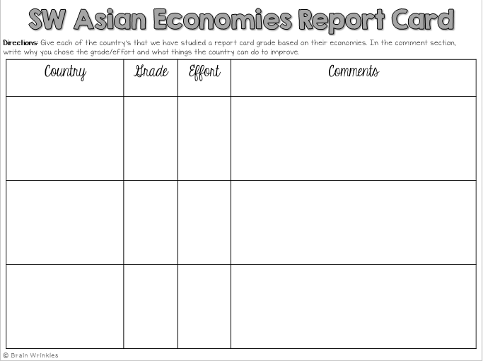
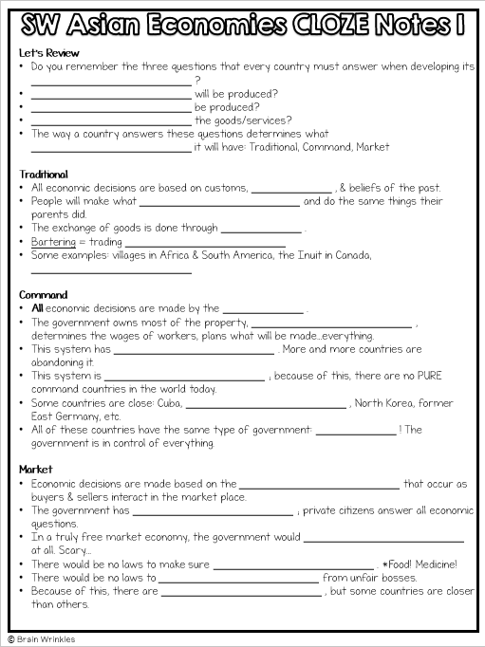
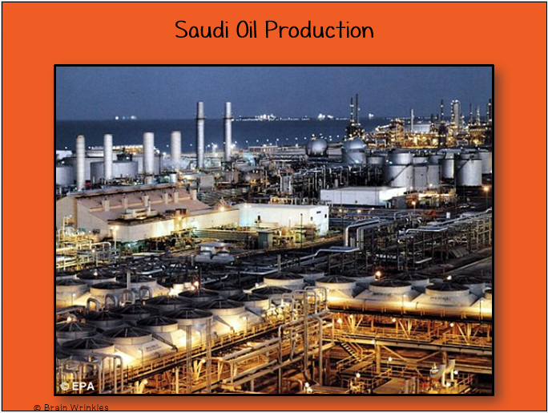
Southwest Asia’s
ECONOMIC
SYSTEMS
ECONOMIC
SYSTEMS
Presentation, Graphic Organizers, & Activities

Slide 2
STANDARDS:
SS7E5 The student will analyze different economic systems.
a. Compare how traditional, command, and market economies answer the economic questions of (1) what to produce, (2) how to produce, and (3) for whom to produce.
b. Explain how most countries have a mixed economy located on a continuum between pure market and pure command.
c. Compare and contrast the economic systems in Israel, Saudi Arabia, and Turkey.
© Brain Wrinkles

Slide 3
TEACHER INFO: CLOZE Notes
The next pages are handouts for the students to use for note-taking during the presentation. (Print front to back to save paper and ink.)
Check the answers as a class after the presentation.
© Brain Wrinkles

Slide 4
Let’s Review
Do you remember the three questions that every country must answer when developing its __________________________ ?
__________________________ will be produced?
__________________________ be produced?
__________________________ the goods/services?
The way a country answers these questions determines what __________________________ it will have: Traditional, Command, Market
Traditional
All economic decisions are based on customs, _____________ , & beliefs of the past.
People will make what __________________________ and do the same things their parents did.
The exchange of goods is done through _____________ .
Bartering = trading __________________________
Some examples: villages in Africa & South America, the Inuit in Canada, __________________________
Command
All economic decisions are made by the _____________ .
The government owns most of the property, __________________________ , determines the wages of workers, plans what will be made…everything.
This system has __________________________ . More and more countries are abandoning it.
This system is __________________________ ; because of this, there are no PURE command countries in the world today.
Some countries are close: Cuba, __________________________ , North Korea, former East Germany, etc.
All of these countries have the same type of government: _____________ ! The government is in control of everything.
Market
Economic decisions are made based on the __________________________ that occur as buyers & sellers interact in the market place.
The government has __________________________ ; private citizens answer all economic questions.
In a truly free market economy, the government would __________________________ at all. Scary…
There would be no laws to make sure __________________________ . *Food! Medicine!
There would be no laws to __________________________ from unfair bosses.
Because of this, there are __________________________ , but some countries are closer than others.
© Brain Wrinkles
SW Asian Economies CLOZE Notes 1

Slide 5
Hmmm…
Since there are _____________ that are purely command or purely market, what does that make them?
Most democratic countries have some __________________________ , so we keep it simple and call them: _____________ .
Of course, most countries’ economies are __________________________ of system than another.
Israel
Israel has a __________________________ .
While __________________________ plays a role in Israel’s economy, the government also has a hand in the country’s economic planning.
For example, the government has been very involved in Israel’s __________________________ to make sure that Israelis are fed.
Israel has the __________________________ economy in Southwest Asia.
Its important industries include: mining, cutting and __________________________ , agriculture, & manufacturing __________________________ .
Also, a high percentage of Israelis work in the __________________________ , as Israel is a popular tourist destination.
What to Produce? Individuals and corporations; government has __________________________
How to Produce? __________________________ ; government has some regulations
For Whom to Produce? Individuals and corporations; __________________________ regulations
Challenges
Since its creation in 1948, Israel has been involved in much __________________________ .
Building up its __________________________ and maintaining its armed forces has put a strain on Israel’s economy.
Another financial burden has been large __________________________ , even though they have brought valuable skills to the country.
© Brain Wrinkles
SW Asian Economies CLOZE Notes 2

Slide 6
SAUDI ARABIA
Past
In 1932, when Saudi Arabia became a nation, its economy was __________________________ and consisted of trading camels, goats, & textiles.
When __________________________ , the Saudi royal family transformed the economy into __________________________ and profited greatly from oil wealth.
Present
Today, the government still controls most of the __________________________ , but it has begun to diversify the Saudi economy in other areas.
The government has begun to encourage private enterprise in areas like power generation and __________________________ ..
With a large part of revenue now coming from private businesses, Saudi Arabia now has a __________________________ .
Saudi Arabia
What to Produce? __________________________ ; government has many restrictions on the oil industry
How to Produce? Individuals and corporations; government has many restrictions on __________________________
For Whom to Produce? Individuals and corporations; government has __________________________ on the oil industry
Challenges
Income from oil __________________________ of the country’s budget; however, oil supplies __________________________ .
Saudi Arabia’s __________________________ is high.
One-third of Saudi Arabia’s jobs are filled by people from other countries because the country has a shortage of __________________________ .
© Brain Wrinkles
SW Asian Economies CLOZE Notes 3

Slide 7
TURKEY
Past
When Turkey became a country in 1923, its ruler Mustafa Kemal set up a __________________________ .
Kemal believed the government should __________________________ the economy, so he invested in the __________________________ : dams, electricity, ports, railroads, and roads.
The government also developed important __________________________ .
Present
Reforms in Turkey since the 1980s have moved it to a __________________________ .
The state still has a major role in industry, __________________________ , banking, and transportation.
Private enterprise is growing in agriculture, textiles, and __________________________ .
Turkey
What to Produce? __________________________ ; government has some regulations on industry, banking, transportation, & communications
How to Produce? Individuals and corporations; government __________________________ on industry, banking, transportation, & communications
For Whom to Produce? Individuals and corporations; government has some regulations on industry, banking, __________________________ , & communications
Challenges
Turkey lies __________________________ and partly in Asia.
Because most of Turkey’s trade is with Western Europe, so it has been trying for years to __________________________ .
Unfortunately, Turkey is considered a __________________________ and remains poor when compared to most European countries.
© Brain Wrinkles
SW Asian Economies CLOZE Notes 4

Slide 8
Let’s Review
Do you remember the three questions that every country must answer when developing its economic plan?
What goods/services will be produced?
How will goods/services be produced?
Who will consume the goods/services?
The way a country answers these questions determines what kind of economic system it will have: Traditional, Command, Market
Traditional
All economic decisions are based on customs, traditions, & beliefs of the past.
People will make what they always made and do the same things their parents did.
The exchange of goods is done through bartering.
Bartering = trading without using money
Some examples: villages in Africa & South America, the Inuit in Canada, Aborigines in Australia
Command
All economic decisions are made by the Government.
The government owns most of the property, sets the prices of goods, determines the wages of workers, plans what will be made…everything.
This system has not been very successful. More and more countries are abandoning it.
This system is very harsh to live under; because of this, there are no PURE command countries in the world today.
Some countries are close: Cuba, former Soviet Union, North Korea, former East Germany, etc.
All of these countries have the same type of government: Communist! The government is in control of everything.
Market
Economic decisions are made based on the changes in prices that occur as buyers & sellers interact in the market place.
The government has no control over the economy; private citizens answer all economic questions.
In a truly free market economy, the government would not be involved at all. Scary…
There would be no laws to make sure goods/services were safe. *Food! Medicine!
There would be no laws to protect workers from unfair bosses.
Because of this, there are no PURE market economies, but some countries are closer than others.
© Brain Wrinkles
SW Asian Economies CLOZE Notes 1

Slide 9
Hmmm…
Since there are no countries that are purely command or purely market, what does that make them?
Most democratic countries have some characteristics of both systems, so we keep it simple and call them: MIXED.
Of course, most countries’ economies are closer to one type of system than another.
Israel
Israel has a mixed economic system.
While private enterprise plays a role in Israel’s economy, the government also has a hand in the country’s economic planning.
For example, the government has been very involved in Israel’s agricultural industry to make sure that Israelis are fed.
Israel has the most diversified economy in Southwest Asia.
Its important industries include: mining, cutting and polishing diamonds, agriculture, & manufacturing tech equipment.
Also, a high percentage of Israelis work in the service industry, as Israel is a popular tourist destination.
What to Produce? Individuals and corporations; government has some regulations
How to Produce? Individuals and corporations; government has some regulations
For Whom to Produce? Individuals and corporations; government has some regulations
Challenges
Since its creation in 1948, Israel has been involved in much conflict with its neighbors.
Building up its national security and maintaining its armed forces has put a strain on Israel’s economy.
Another financial burden has been large volumes of immigrants, even though they have brought valuable skills to the country.
© Brain Wrinkles
SW Asian Economies CLOZE Notes 2

Slide 10
SAUDI ARABIA
Past
In 1932, when Saudi Arabia became a nation, its economy was mostly traditional and consisted of trading camels, goats, & textiles.
When oil was discovered, the Saudi royal family transformed the economy into mostly command and profited greatly from oil wealth.
Present
Today, the government still controls most of the oil industry, but it has begun to diversify the Saudi economy in other areas.
The government has begun to encourage private enterprise in areas like power generation and natural gas exploration..
With a large part of revenue now coming from private businesses, Saudi Arabia now has a mixed economy.
Saudi Arabia
What to Produce? Individuals and corporations; government has many restrictions on the oil industry
How to Produce? Individuals and corporations; government has many restrictions on the oil industry
For Whom to Produce? Individuals and corporations; government has many restrictions on the oil industry
Challenges
Income from oil accounts for 75% of the country’s budget; however, oil supplies don’t last forever.
Saudi Arabia’s unemployment rate is high.
One-third of Saudi Arabia’s jobs are filled by people from other countries because the country has a shortage of skilled native labor.
© Brain Wrinkles
SW Asian Economies CLOZE Notes 3

Slide 11
TURKEY
Past
When Turkey became a country in 1923, its ruler Mustafa Kemal set up a command economy.
Kemal believed the government should control & build the economy, so he invested in the country’s infrastructure: dams, electricity, ports, railroads, and roads.
The government also developed important steel and weapon industries.
Present
Reforms in Turkey since the 1980s have moved it to a mixed economy.
The state still has a major role in industry, communication, banking, and transportation.
Private enterprise is growing in agriculture, textiles, and manufacturing.
Turkey
What to Produce? Individuals and corporations; government has some regulations on industry, banking, transportation, & communications
How to Produce? Individuals and corporations; government has some regulations on industry, banking, transportation, & communications
For Whom to Produce? Individuals and corporations; government has some regulations on industry, banking, transportation, & communications
Challenges
Turkey lies partly in Europe and partly in Asia.
Because most of Turkey’s trade is with Western Europe, so it has been trying for years to join the European Union.
Unfortunately, Turkey is considered a developing nation and remains poor when compared to most European countries.
© Brain Wrinkles
SW Asian Economies CLOZE Notes 4

Slide 12
Southwest Asia’s
Economic
Systems
Israel, Saudi Arabia,
& Turkey
© Brain Wrinkles

Slide 13
Let’s Review
Do you remember the three questions that every country must answer when developing its economic plan?
What goods/services will be produced?
How will goods/services be produced?
Who will consume the goods/services?
The way a country answers these questions determines what kind of economic system it will have:
Traditional Command Market
© Brain Wrinkles

Slide 14
Traditional
All economic decisions are based on customs, traditions, & beliefs of the past.
People will make what they always made and do the same things their parents did.
The exchange of goods is done through bartering.
Bartering = trading without using money
Some examples: villages in Africa & Asia, the Inuit in Canada, Aborigines in Australia
© Brain Wrinkles

Slide 15
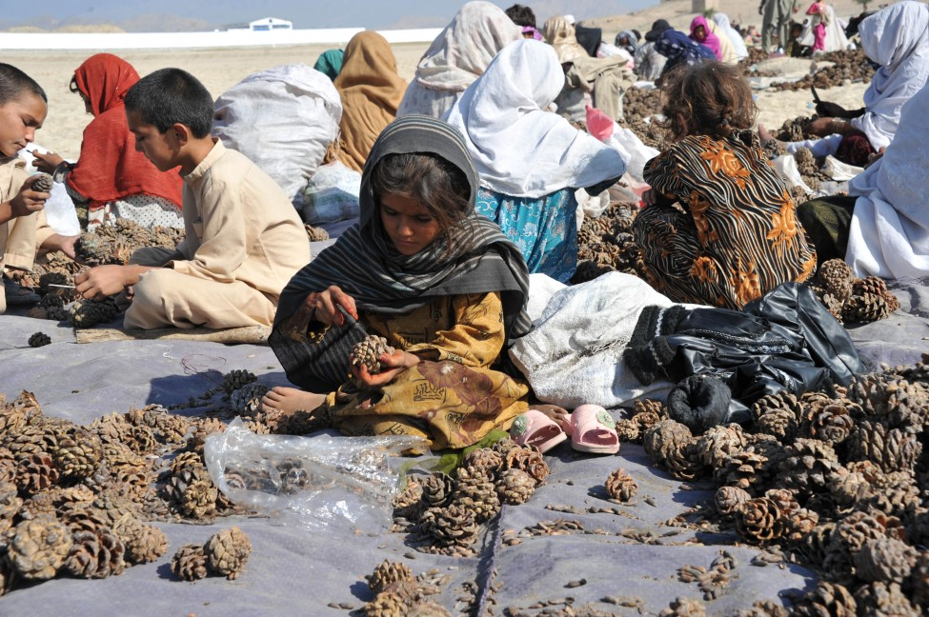
Afghan Village Traditional Economy
© Brain Wrinkles

Slide 16
Command
All economic decisions are made by the Government.
The government owns most of the property, sets the prices of goods, determines the wages of workers, plans what will be made…everything.
This system has not been very successful. More and more countries are abandoning it.
© Brain Wrinkles

Slide 17
Command
This system is very harsh to live under; because of this, there are no PURE command countries in the world today.
Some countries are close: Cuba, former Soviet Union, North Korea, former East Germany, etc.
All of these countries have the same type of government: Communist! The government is in control of everything.
© Brain Wrinkles

Slide 18
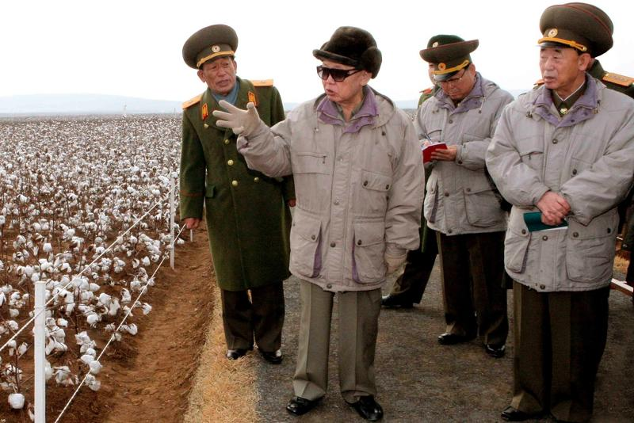
North Korea’s Command Economy
© Brain Wrinkles

Slide 19
Market
Economic decisions are made based on the changes in prices that occur as buyers & sellers interact in the market place.
The government has no control over the economy; private citizens answer all economic questions.
In a truly free market economy, the government would not be involved at all. Scary…
There would be no laws to make sure goods/services were safe. *Food! Medicine!
There would be no laws to protect workers from unfair bosses.
Because of this, there are no PURE market economies, but some countries are closer than others.
© Brain Wrinkles

Slide 20
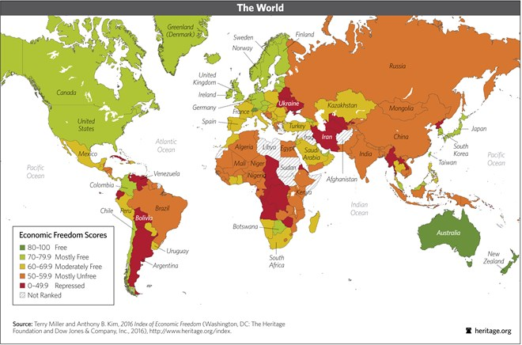
2016 Index of Economic Freedom
© Brain Wrinkles

Slide 21
Hmmm…
Since there are no countries that are purely command or purely market, what does that make them?
Most democratic countries have some characteristics of both systems, so we keep it simple and call them: MIXED.
Of course, most countries’ economies are closer to one type of system than another.
© Brain Wrinkles

Slide 22
ISRAEL
© Brain Wrinkles

Slide 23
Israel
Israel has a mixed economic system.
While private enterprise plays a role in Israel’s economy, the government also has a hand in the country’s economic planning.
For example, the government has been very involved in Israel’s agricultural industry to make sure that Israelis are fed.
© Brain Wrinkles

Slide 24
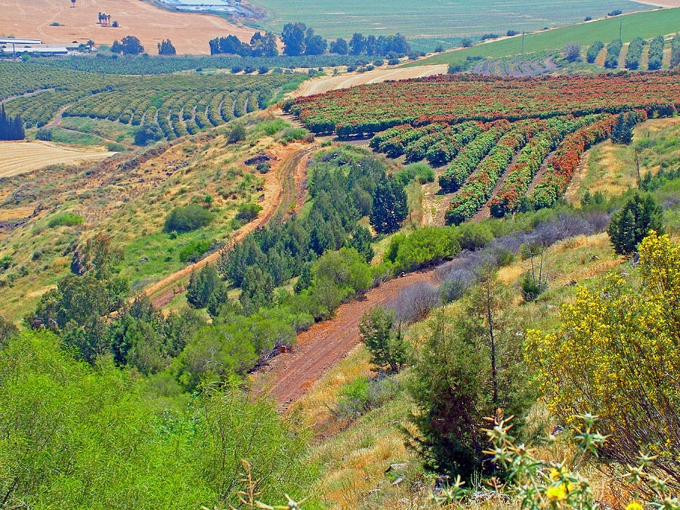
© Brain Wrinkles

Slide 25
Israel
Israel has the most diversified economy in Southwest Asia.
Its important industries include: mining, cutting and polishing diamonds, agriculture, & manufacturing tech equipment.
Also, a high percentage of Israelis work in the service industry, as Israel is a popular tourist destination.
© Brain Wrinkles

Slide 26
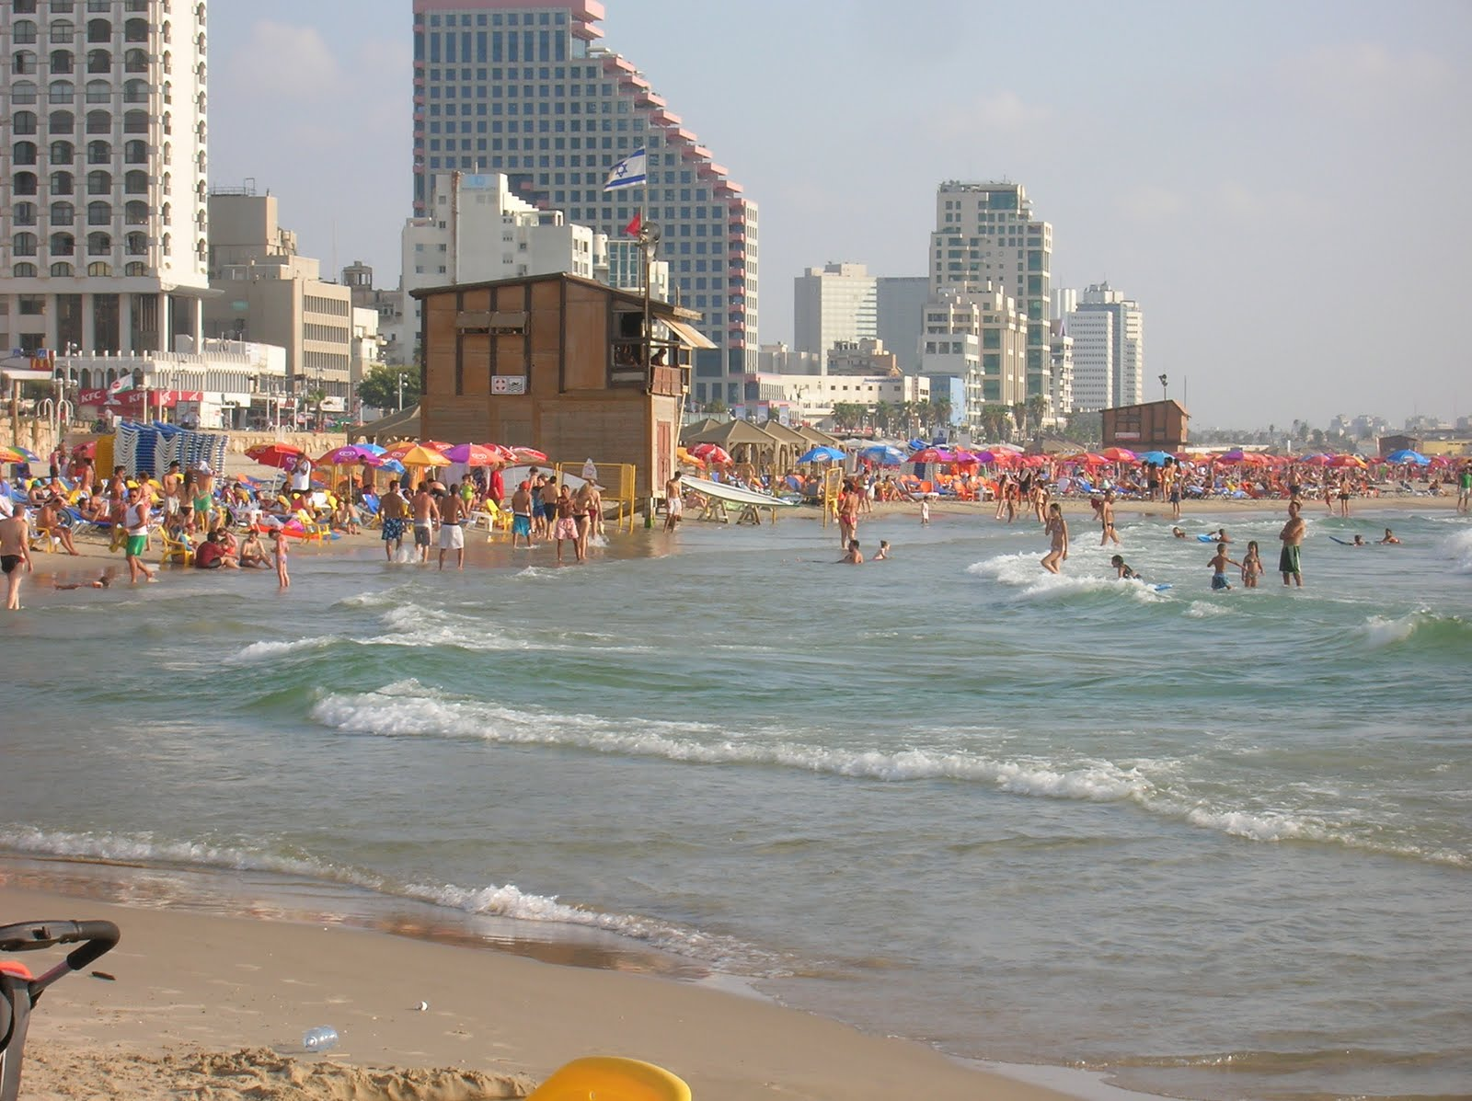
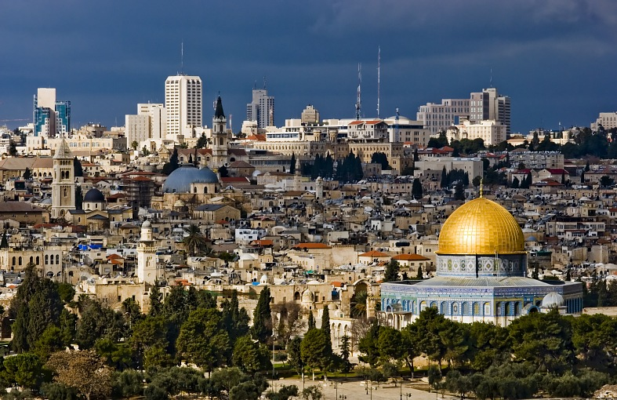
Israel’s Tourist Destinations:
Tel Aviv
Jerusalem
© Brain Wrinkles

Slide 27
Israel
What to Produce? Individuals and corporations; government has some regulations
How to Produce? Individuals and corporations; government has some regulations
For Whom to Produce? Individuals and corporations; government has some regulations
© Brain Wrinkles

Slide 28
Challenges
Since its creation in 1948, Israel has been involved in much conflict with its neighbors.
Building up its national security and maintaining its armed forces has put a strain on Israel’s economy.
Another financial burden has been large volumes of immigrants, even though they have brought valuable skills to the country.
© Brain Wrinkles

Slide 29
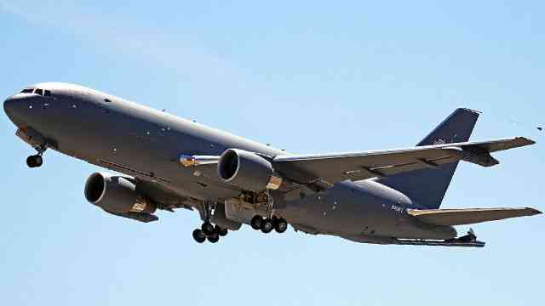
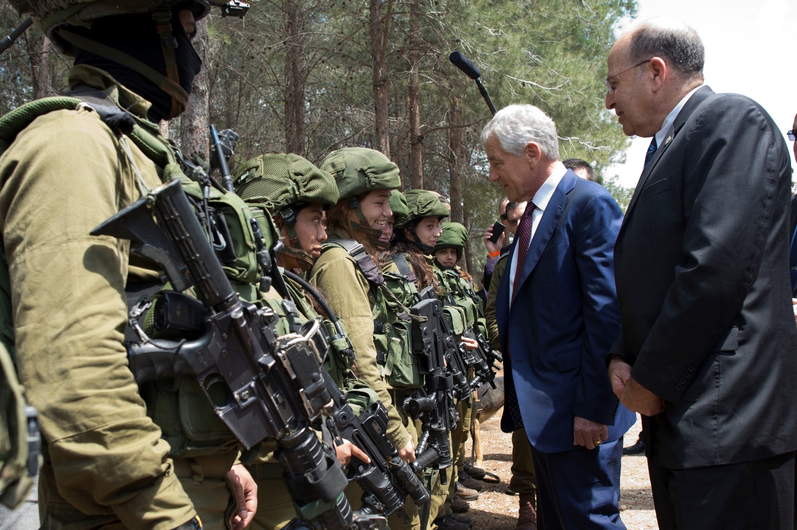
© Brain Wrinkles

Slide 30
SAUDI
ARABIA
© Brain Wrinkles

Slide 31
Past
In 1932, when Saudi Arabia became a nation, its economy was mostly traditional and consisted of trading camels, goats, & textiles.
When oil was discovered, the Saudi royal family transformed the economy into mostly command and profited greatly from oil wealth.
© Brain Wrinkles

Slide 32
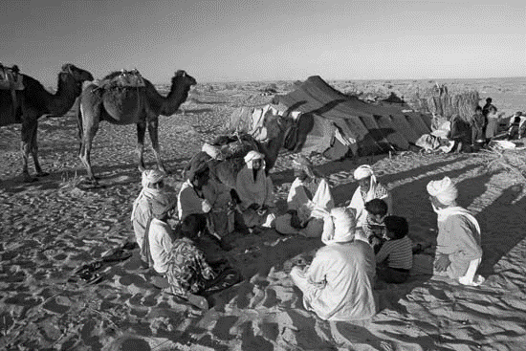
© Brain Wrinkles

Slide 33
Present
Today, the government still controls most of the oil industry, but it has begun to diversify the Saudi economy in other areas.
The government has begun to encourage private enterprise in areas like power generation and natural gas exploration..
With a large part of revenue now coming from private businesses, Saudi Arabia now has a mixed economy.
© Brain Wrinkles

Slide 34
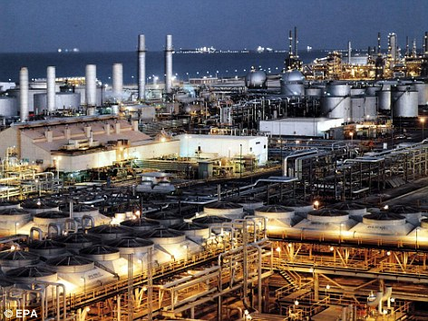
Saudi Oil Production
© Brain Wrinkles

Slide 35
Saudi Arabia
What to Produce? Individuals and corporations; government has many restrictions on the oil industry
How to Produce? Individuals and corporations; government has many restrictions on the oil industry
For Whom to Produce? Individuals and corporations; government has many restrictions on the oil industry
© Brain Wrinkles

Slide 36
Challenges
Income from oil accounts for 75% of the country’s budget; however, oil supplies don’t last forever.
Saudi Arabia’s unemployment rate is high.
One-third of Saudi Arabia’s jobs are filled by people from other countries because the country has a shortage of skilled native labor.
© Brain Wrinkles

Slide 37
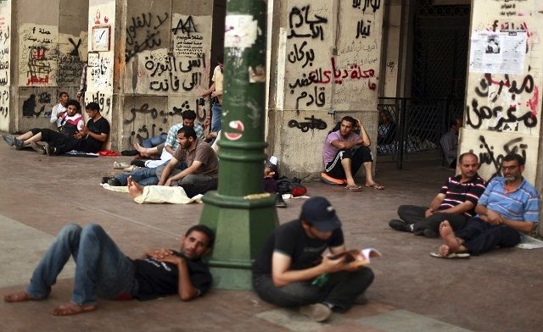
© Brain Wrinkles

Slide 38
TURKEY
© Brain Wrinkles

Slide 39
Past
When Turkey became a country in 1923, its ruler Mustafa Kemal set up a command economy.
Kemal believed the government should control & build the economy, so he invested in the country’s infrastructure: dams, electricity, ports, railroads, and roads.
The government also developed important steel and weapon industries.
© Brain Wrinkles

Slide 40
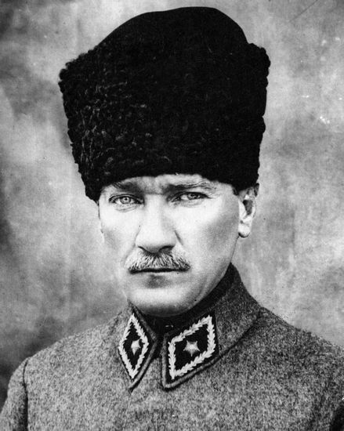
Mustafa Kemal Ataturk
© Brain Wrinkles

Slide 41
Present
Reforms in Turkey since the 1980s have moved it to a mixed economy.
The state still has a major role in industry, communication, banking, and transportation.
Private enterprise is growing in agriculture, textiles, and manufacturing.
© Brain Wrinkles

Slide 42
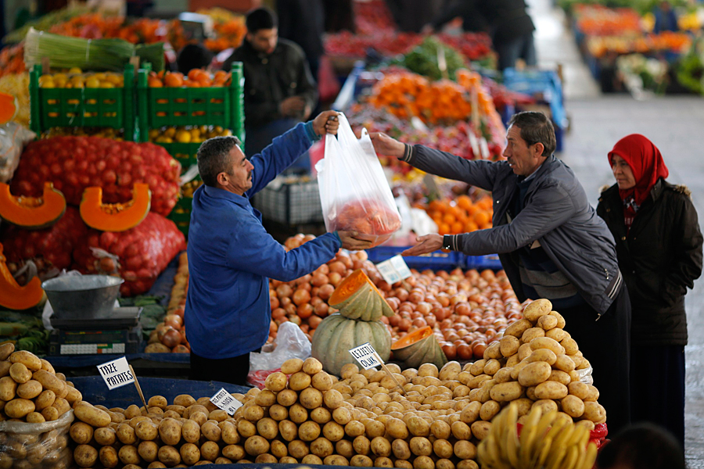
Private enterprise is growing in the agricultural industry.
© Brain Wrinkles

Slide 43
Turkey
What to Produce? Individuals and corporations; government has some regulations on industry, banking, transportation, & communications
How to Produce? Individuals and corporations; government has some regulations on industry, banking, transportation, & communications
For Whom to Produce? Individuals and corporations; government has some regulations on industry, banking, transportation, & communications
© Brain Wrinkles

Slide 44
Challenges
Turkey lies partly in Europe and partly in Asia.
Because most of Turkey’s trade is with Western Europe, so it has been trying for years to join the European Union.
Unfortunately, Turkey is considered a developing nation and remains poor when compared to most European countries.
© Brain Wrinkles

Slide 45
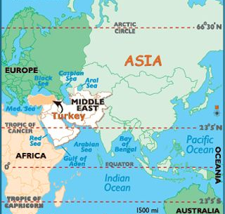
© Brain Wrinkles

Slide 46
TEACHER INFO:
Print off the chart below for each student.
They should complete the charts after discussing the presentation.
Check answers as a class when finished.
© Brain Wrinkles

Slide 47
Southwest Asia’s Economic Systems
Directions: Complete the chart below with information that you learned during the presentation.
 | Economic System | What to Produce? | How to Produce? | For Whom to Produce? | Economic Struggles
Israel
Saudi Arabia
Turkey
© Brain Wrinkles

Slide 48
Southwest Asia’s Economic Systems
Directions: Complete the chart below with information that you learned during the presentation.
 | Economic System | What to Produce? | How to Produce? | For Whom to Produce? | Economic Struggles
Israel | Mixed | Individuals and corporations; government has some regulations | Individuals and corporations; government has some regulations | Individuals and corporations; government has some regulations | Has been involved in much conflict with its neighbors; building up its national security; large volumes of immigrants
Saudi Arabia | Mixed, moving away from command | Individuals and corporations; government has many restrictions on the oil industry | Individuals and corporations; government has many restrictions on the oil industry | Individuals and corporations; government has many restrictions on the oil industry | Oil supplies don’t last forever; unemployment rate is high; One-third of Saudi Arabia’s jobs are filled by people from other countries because the country has a shortage of skilled native labor.
Turkey | Mixed, moving away from command | Individuals and corporations; government has some regulations on industry, banking, transportation, & communications | Individuals and corporations; government has some regulations on industry, banking, transportation, & communications | Individuals and corporations; government has some regulations on industry, banking, transportation, & communications | Wants to join EU because of trade with Western Europe; Considered a developing nation & remains poor compared to European countries
© Brain Wrinkles

Slide 49
TEACHER INFO: Economies Report Card
Project the following slide onto the board and print off the Report Card handout for each student.
The students will “grade” each country’s economy.
In the “comments” section, they will write why they chose that particular grade and also ways the country can improve in the future.
© Brain Wrinkles

Slide 50
SW Asian Economies Report Card
Directions: Give each of the country’s that we have studied a report card grade based on their economies. In the comment section, write why you chose the grade/effort and what things the country can do to improve.
Country | Grade | Effort | Comments
© Brain Wrinkles

Slide 51
TEACHER INFO: Award Goes To…
Print off the Award handout for each student.
The students will choose one of the countries from the lesson and design an award that the country’s economic will receive.
Next, they will write an acceptance speech from the perspective of the country’s leader where s/he explains why the country deserves the award.
© Brain Wrinkles

Slide 52
The Award Goes To…
Directions: Choose one of the countries from this lesson and create an award (design the trophy) for that country’s economy. Next, write a speech from the country’s leader’s perspective about why the economy is being honored with the award.
© Brain Wrinkles

Slide 53
TEACHER INFO: Comprehension Check
Print off the Comprehension Check for each student.
After the lesson, have the students answer the questions. *This could also be used as a quiz.
© Brain Wrinkles

Slide 54
What are the three economic questions that every country must answer?
2. How do members of a traditional economy trade goods?
3. How does a command economic system answer the three economic questions?
4. Give an example of a pure market economy:
5. What type of economic system do most democratic countries have?
6. Which country has the most diversified economy in the Middle East?
7. What have been challenges to Israel’s economy?
8. Since Saudi Arabia became a nation in 1932, it has had 3 economic systems. What are they?
9. How has Saudi Arabia set up private enterprise over the last 30 years?
10. What economic challenges is Saudi Arabia facing?
11. What type of economic system is found in the Turkey?
12. How has Turkey moved from a command economy to a mixed economy since the 1980s?
© Brain Wrinkles
SW Asian Economies
Comprehension Check

Slide 55
1. What are the three economic questions that every country must answer?
What to produce, how to produce, for whom to produce
2. How do members of a traditional economy trade goods?
Bartering
3. How does a command economic system answer the three economic questions?
Government makes all decisions
4. Give an example of a pure market economy:
There are none, but US is close
5. What type of economic system do most democratic countries have?
Mixed
6. Which country has the most diversified economy in the Middle East?
Israel
7. What has been a challenge to Israel’s economy?
National security and immigration
8. Since Saudi Arabia became a nation in 1932, it has had 3 economic systems. What are they?
Traditional, then command, now mixed
9. How has Saudi Arabia set up private enterprise over the last 30 years?
Government has encourage private ownership of power generation and natural gas exploration
10. What economic challenges is Saudi Arabia facing?
Diversifying economy because oil supplies will run out; high unemployment; unskilled native workforce
11. What type of economic system is found in the Turkey?
Mixed
12. How has Turkey moved from a command economy to a mixed economy since the 1980s?
Government still has a major role in industry, communication, banking, and transportation; but private enterprise is growing in agriculture, textiles, and manufacturing.
© Brain Wrinkles
SW Asian Economies
Comprehension Check

Slide 56
TEACHER INFO: TICKET OUT THE DOOR
Print out the exit slip page for each student (two-per-page).
Have students write down the single most important thing that they can remember from the lesson.
After class, read over the slips and address the key ideas/misconceptions. This is a helpful slip to use to see what needs to be taught again.
© Brain Wrinkles

Slide 57
Name:
Name:
Note to Self
Note to Self
What is the most important thing that you remember from today’s lesson?
What is the most important thing that you remember from today’s lesson?
© Brain Wrinkles
© Brain Wrinkles

Slide 58
Thank You!
Thank you so much for downloading this file. I sincerely hope you find it helpful and that your students learn a lot from it! I look forward to reading your feedback in my store.
If you like this file, you might want to check out some of my other products that teach social studies topics in creative, engaging, and hands-on ways.
Best wishes,
Ansley at Brain Wrinkles

Slide 59
© Brain Wrinkles. Your download includes a limited use license from Brain Wrinkles. The purchaser may use the resource for personal classroom use only. The license is not transferable to another person. Other teachers should purchase their own license through my store.
This resource is not to be used:
By an entire grade level, school, or district without purchasing the proper number of licenses. For school/district licenses at a discount, please contact me.
As part of a product listed for sale or for free by another individual.
On shared databases.
Online in any way other than on password-protected website for student use only.
© Copyright Brain Wrinkles. All rights reserved. Permission is granted to copy pages specifically designed for student or teacher use by the original purchaser or licensee. The reproduction of any other part of this product is strictly prohibited. Copying any part of this product and placing it on the Internet in any form (even a personal/classroom website) is strictly forbidden. Doing so makes it possible for an Internet search to make the document available on the Internet, free of charge, and is a violation of the Digital Millennium Copyright Act (DMCA).
Thank you,
Ansley at Brain Wrinkles
Terms of Use
Clipart, fonts, & digital papers for this product were purchased from:

