Slide 1
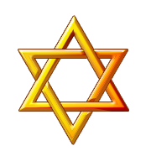
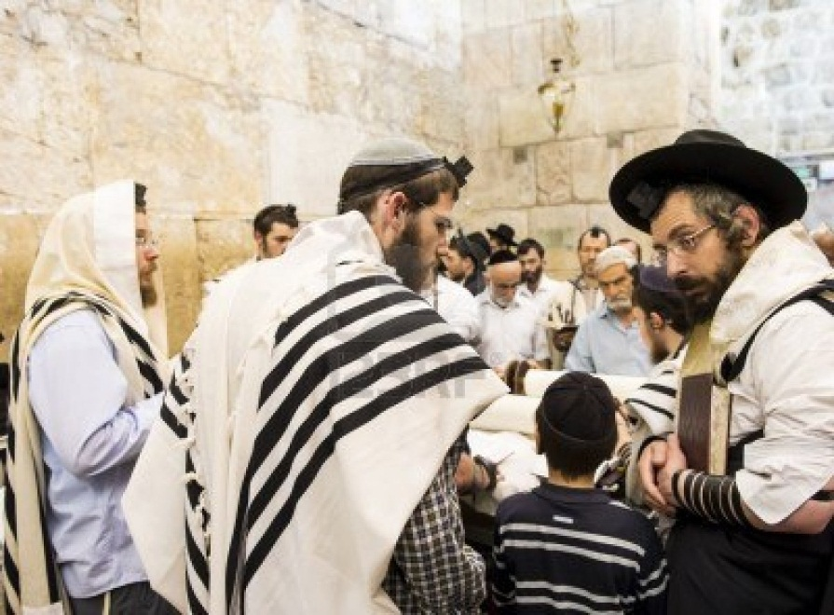
Judaism
Judaism is one of the oldest monotheistic religions in the world – over 3500 years old. (@1800 BCE)
Monotheistic means a belief in one god (usually referred to as God or Yahweh).
Jewish people believe that God appointed them to be the “chosen people” and that they would set an example of holiness and ethical behavior to the world.
Jewish men praying at the Wailing Wall

Slide 2
History
Founded by Abraham around 1800 B.C.E.
Yahweh (God) made a covenant with Abram and his wife, Sarai, that he would have many descendants who would live in Canaan, which they called the promise land.

Slide 3
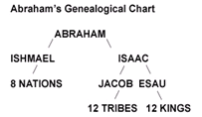
Yahweh changed Abram and Sarai’s names to Abraham and Sarah as a sign of the convent.
Abraham and Sarah had a son name Isaac.
All of the people who have descended from Abraham through Isaac are known as Jews.

Slide 4
During 1300 B.C.E. the Jewish people moved from the Promise Land to Egypt in search of food during a time of famine. They became slaves to the Egyptian king during this time.
The Jews were freed by Moses and returned to the Promise Land and built a temple to worship Yahweh in the city of Jerusalem. This temple was destroyed by the Romans in about 60 C.E. and has never been rebuilt.

Slide 5
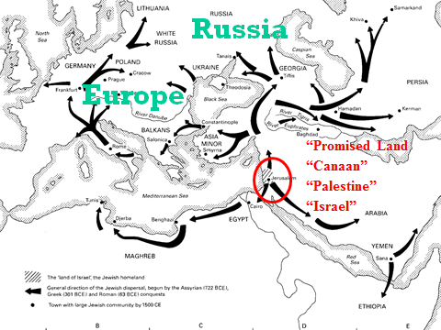
Jewish people dispersed, spread out, to many parts of the world. (Jewish Diaspora)
Zionism: a movement which encourages all Jews to return to the promise land, present day Israel.

Slide 6
Symbols
Star of David: Six pointed star, is said to stand for the Shield of David, an ancient king and important figure in the Hebrew Bible.

Slide 7
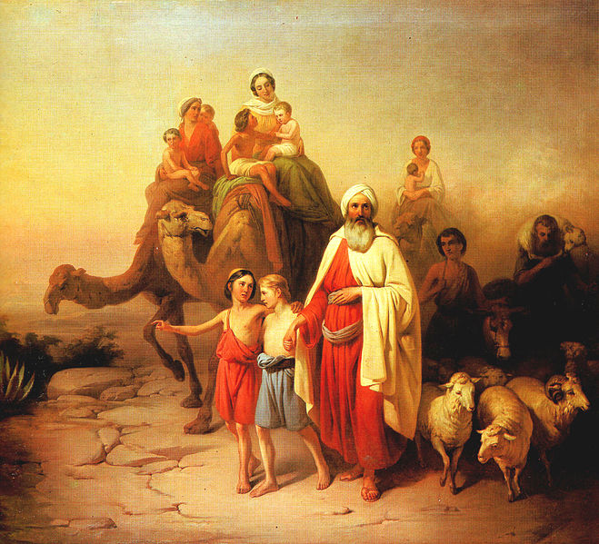
Key Beliefs
Judaism is the original of the three Abrahamic faiths, with the other two being Christianity and Islam.
Each of these religions trace their origins to Abraham, who is credited with founding Judaism.
Abraham's Journey from Ur to Canaan by József Molnár

Slide 8
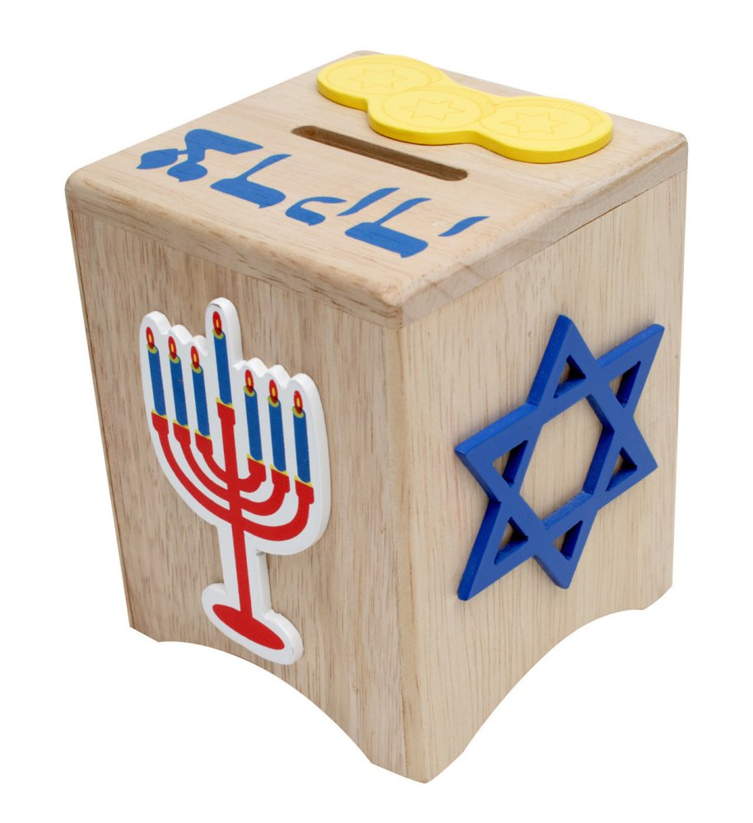
Key Beliefs (cont.)
People are usually considered Jewish if their mother is Jewish, although some groups also accept children of Jewish fathers as Jewish.
Judaism is a community of faith. Jewish people believe that they should be judged by their actions (how much they contribute to the overall holiness of the world).
A Tzedakah box – money is kept here by Jewish families, to later be donated to charity.

Slide 9
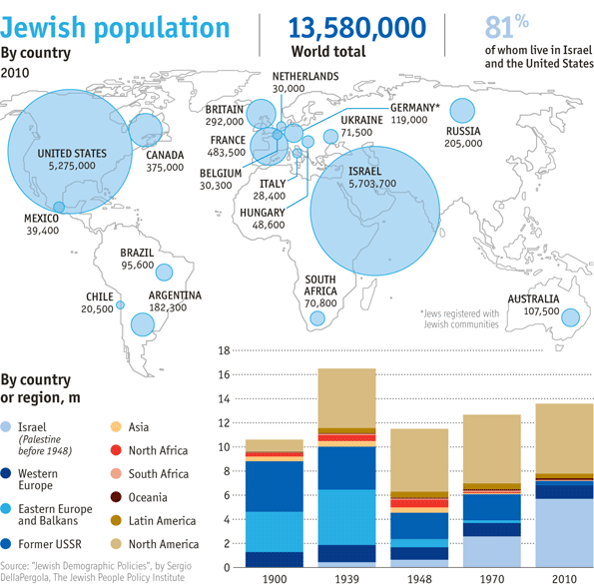
Judaism at a Glance
There are around 13.6 million Jewish people in the world, most of which live in the USA or Israel.
Jewish people are located all over the world due to the diaspora (dispersion of people around the world).

Slide 10
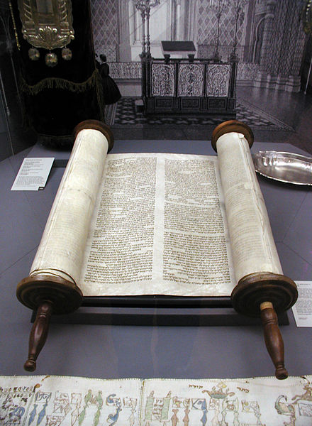
Holy Book
Judaism has a rich history of religious text, but the central and most important religious texts are the Torah and Talmud.
The Torah is included in the Christian Bible, as it makes up the first five books of the Old Testament.
Talmud: writings that often venture onto other subjects and expounds broadly on the Hebrew Bible
Sefer Torah at old Glockengasse Synagogue (reconstruction), Cologne, Germany

Slide 11
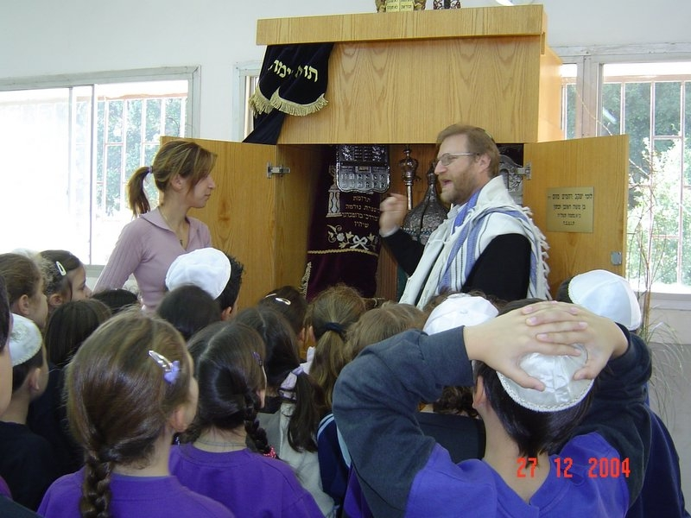
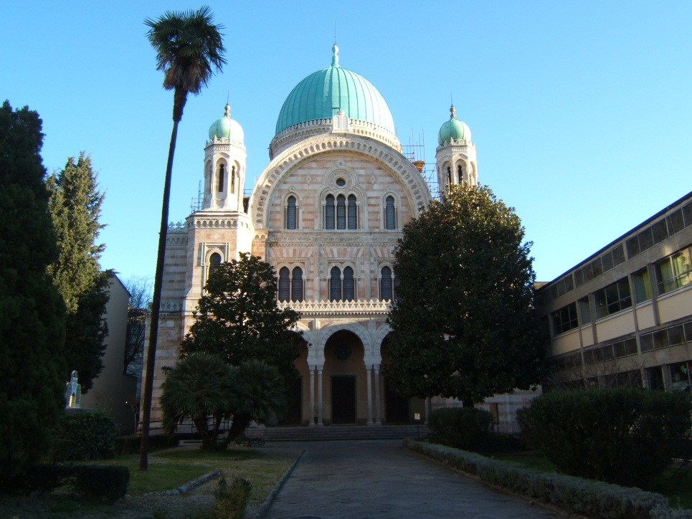
Worship Services
Jewish spiritual leaders are called Rabbis and Jewish people worship at Synagogues.
A rabbi teaching Jewish children
The Great Synagogue of Florence, Italy

Slide 12
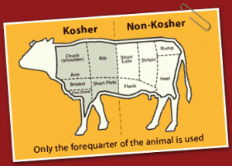
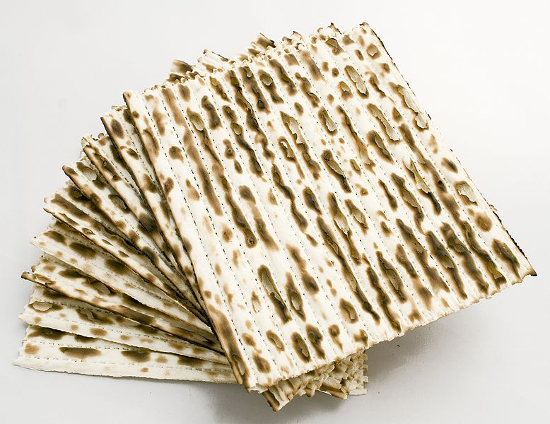
Practices and Rituals
According to Jewish beliefs and practices, food should be kosher (meaning that it is “fit for consumption”; also must be handled and prepared in a proper way, according to the Torah).
Matza – Unleavened bread eaten by Jewish people during Passover.

Slide 13
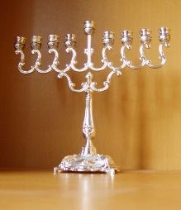
Holidays/Festivals
Rosh Hashanah: The Jewish New Year festival and commemorates the creation of the world.
Yom Kippur: When Jews seek forgiveness for things which they have done wrong.
Passover: Celebrates the escape from Egypt. Begins with a meal called the Seder where the youngest child asks questions and the Passover story is retold.
Hanukkah: Marks the phenomenal victory of a group of Jews called the Maccabees over the Syrian Greeks.
https://www.youtube.com/watch?v=G40SlkmZkqU

