Slide 1
Apartheid
in South Africa
Nelson Mandela & F.W. de Klerk
© 2014 Brain Wrinkles

Slide 2
Standards
SS7H1 The student will analyze continuity and change in Africa leading to the 21st century.
c. Explain the creation and end of apartheid in South Africa and the roles of Nelson Mandela and F.W. de Klerk.
© 2014 Brain Wrinkles

Slide 3
Which European powers colonized South Africa?
Which political party came to power in South Africa in 1948?
What were the apartheid laws?
How did the apartheid laws impact lives?
What did the Bantu Authorities Act do in 1952?
What was the African National Congress?
Who was Nelson Mandela?
What was the Sharpeville Massacre?
How did South Africa’s government react to the ANC and Mandela?
Describe Mandela’s prison experience:
Who was F.W. de Klerk?
How did he change South African policy?
Why did de Klerk and Mandela win the Nobel Peace Prize?
What is significant about the year 1994?
What is South Africa like today?
© 2014 Brain Wrinkles
Apartheid Questions

Slide 4
Colonization
In the 1600s, the British and the Dutch colonized South Africa.
More European settlers came to South Africa than to anywhere else on the continent.
South Africa was eventually seized by the British from the Dutch settlers (after the Boer War).
In 1910, Great Britain established the Union of South Africa and it became part of the British commonwealth.
Power was only given to whites.
© 2014 Brain Wrinkles

Slide 5
Apartheid
In 1948, a new political party, the National Party, came to power and voted to implement a series of restrictive segregationist laws, known collectively as apartheid.
The National Party enforced the policy of apartheid through legislation across South Africa.
Apartheid was a social and political policy of racial segregation and discrimination.
In Afrikaans (the language of white South Africans), apartheid means “apartness”.
© 2014 Brain Wrinkles

Slide 6
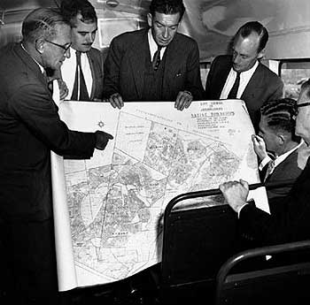
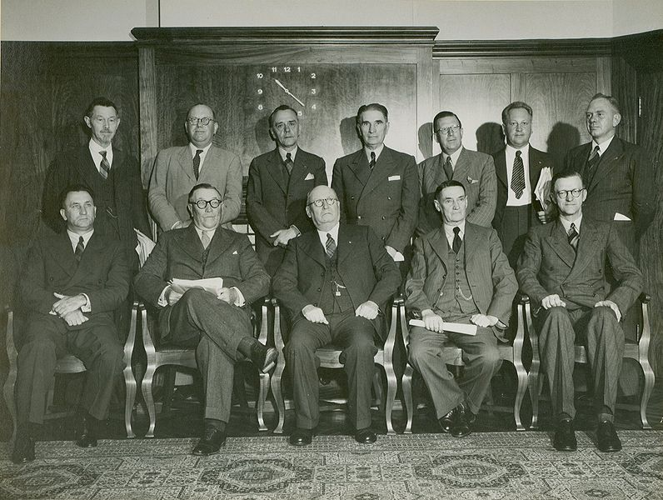
National Party, 1948
© 2014 Brain Wrinkles

Slide 7
Segregation
The policy of apartheid took a strong hold in the country.
It separated South Africa into whites and non-whites, restricting where blacks could live, work, travel, sit, go to the bathroom, eat, etc.
Under apartheid, blacks could not vote or participate in government.
What does this remind you of??
© 2014 Brain Wrinkles

Slide 8
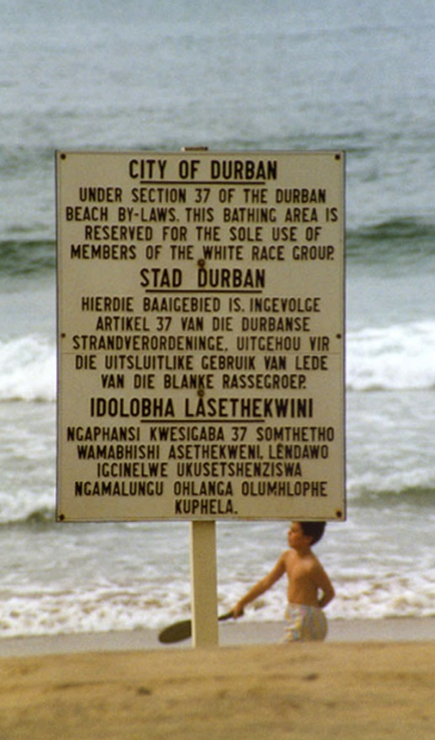
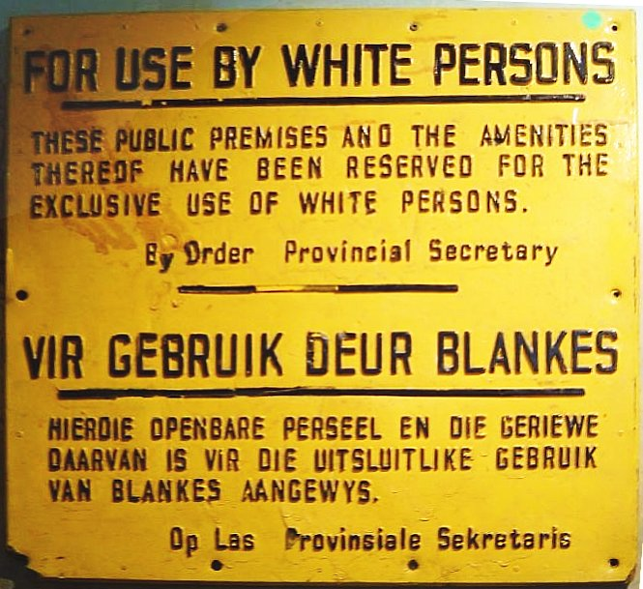
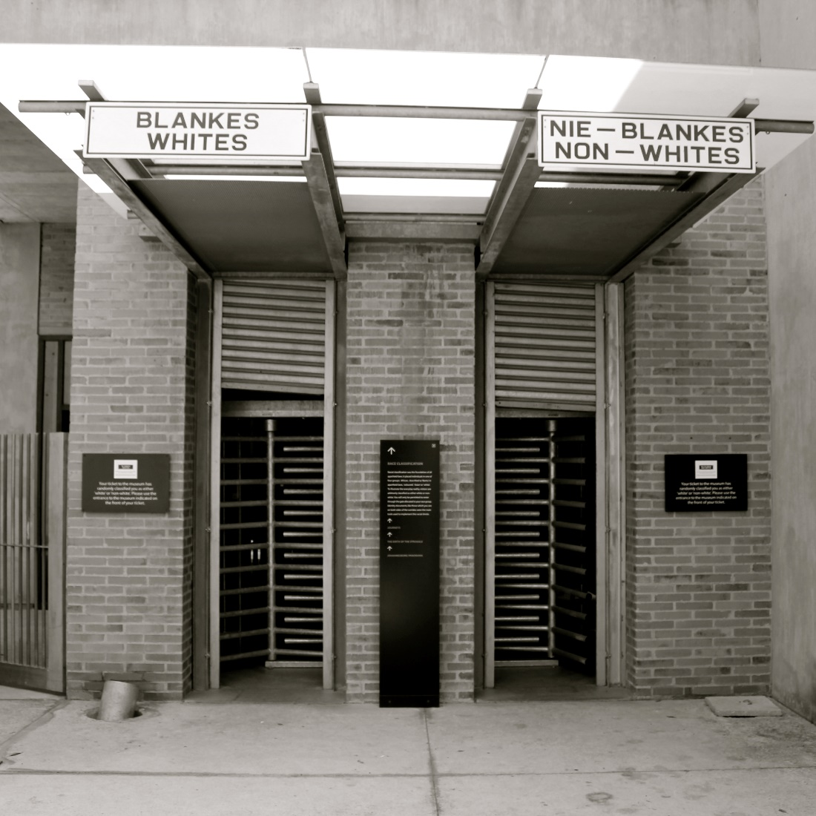
© 2014 Brain Wrinkles

Slide 9
Bantu Authorities Act
In 1951, government officials created the Bantu Authorities Act, which created “homelands” for black South Africans.
At this time, whites owned 80% of the land, although they only represented 10% of the population.
As a result of this law, 9 million South Africans were excluded from participating in the government.
© 2014 Brain Wrinkles

Slide 10
Life Under Apartheid
Apartheid allowed many whites to grow wealthy and powerful, while millions of blacks suffered.
Afrikaners lived in up-scale neighborhoods while native South Africans lived in slums or in Bantustans.
Bantustans were artificially created reservations (“homelands”) for native Africans to live on.
Bantustans offered a poor quality of land and were unfit for the large populations forced to live there.
South Africans were unable to leave their Bantustan without a passport.
© 2014 Brain Wrinkles

Slide 11
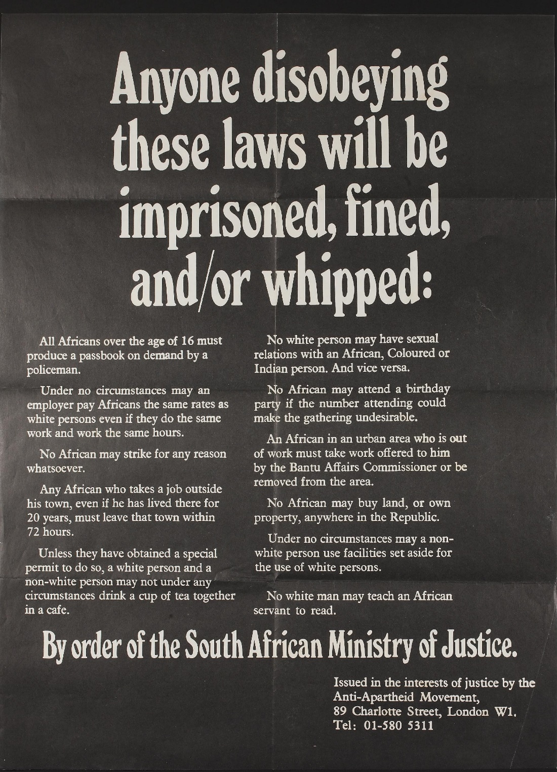
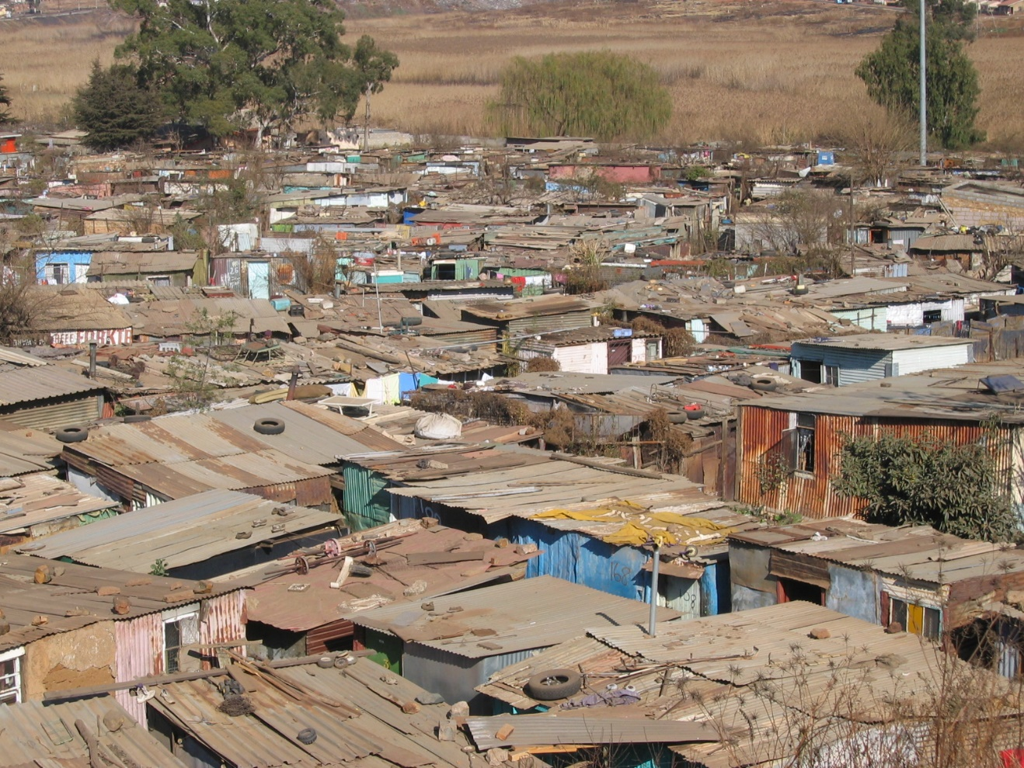
© 2014 Brain Wrinkles

Slide 12
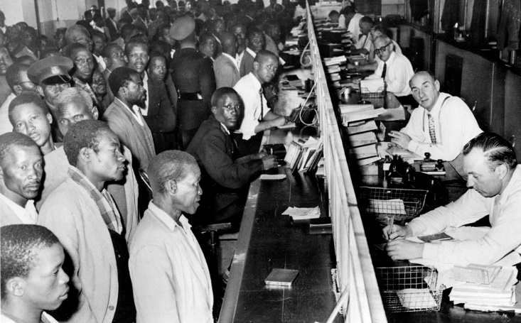
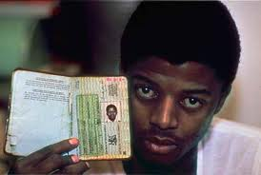
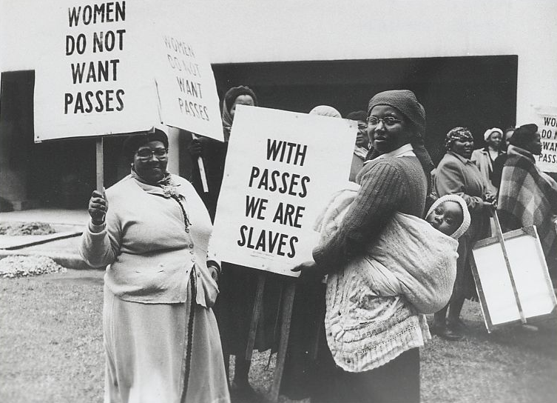
Black South Africans line up at the counter of a government office to get their new passbooks in Johannesburg, South Africa, April 7, 1960.
© 2014 Brain Wrinkles

Slide 13
A.N.C.
In the 1950s, the African National Congress, or ANC, began to actively fight apartheid.
The goal of the ANC was to increase rights of native Africans, although the group had no real power in government.
Eventually, the ANC was declared illegal by the South African government and members were often arrested.
© 2014 Brain Wrinkles

Slide 14
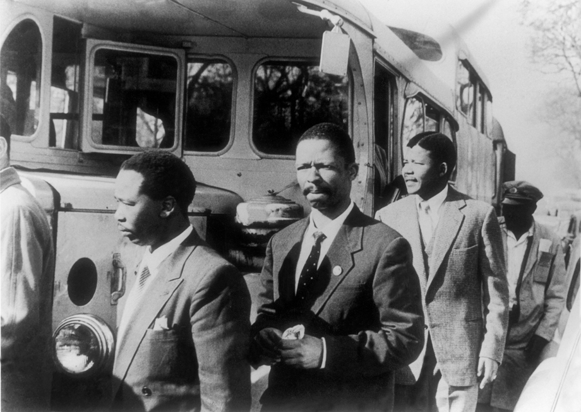
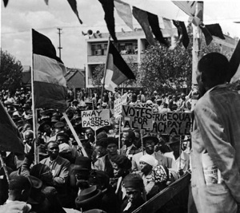
ANC Members (Nelson Mandela, second from right)
© 2014 Brain Wrinkles

Slide 15
Nelson Mandela
Rolihlahla Mandela was born on July 18, 1918 in South Africa.
He was a member of the Thimbu tribe, and his father was chief of the city of Mvezo.
His father died when he was 9, and he was sent to live with a tribal chief who took care of his education.
On his first day of school, his teacher gave him the name of Nelson.
Even though he was the first person in his family to attend school, he was an excellent student.
After graduating college, he became a lawyer.
Mandela became a prominent member of the African National Congress and participated in numerous ANC-led protests against apartheid.
© 2014 Brain Wrinkles

Slide 16
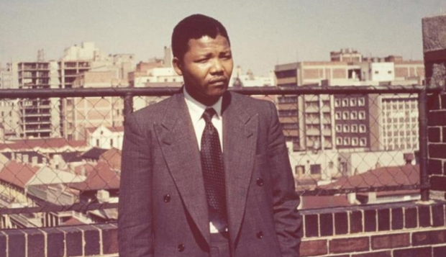
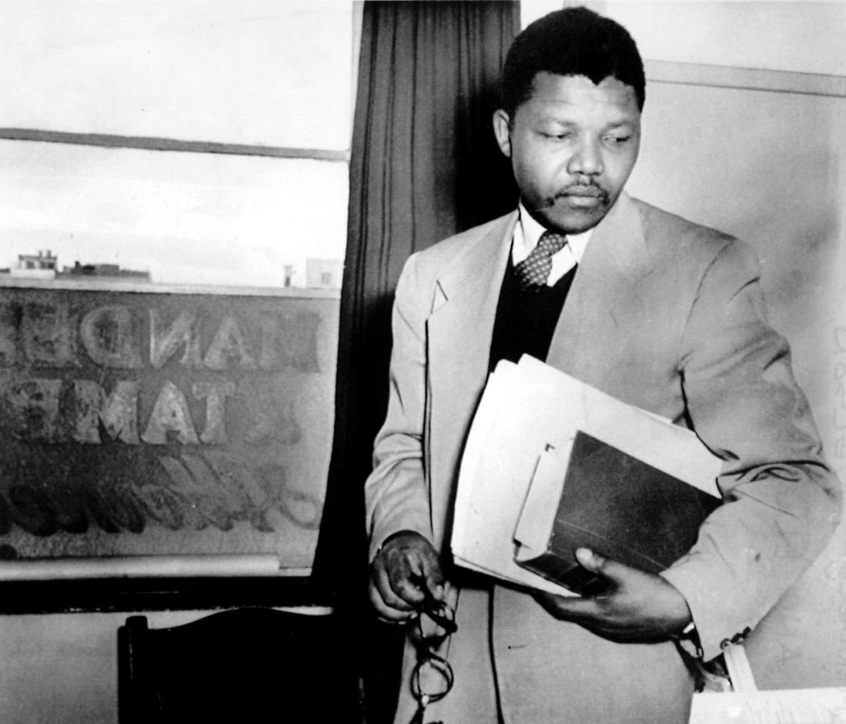
© 2014 Brain Wrinkles

Slide 17
Sharpeville
Nelson Mandela admired Gandhi, who had used peaceful protests in India.
He urged the ANC members to follow Gandhi’s beliefs in non-violent protests.
In 1960, a peaceful protest of apartheid at the town of Sharpeville turned violent as South African policemen fired on the protestors.
69 people were killed and 180 were wounded.
After this, the ANC and Mandela began to advocate more violent methods of protesting the government.
© 2014 Brain Wrinkles

Slide 18
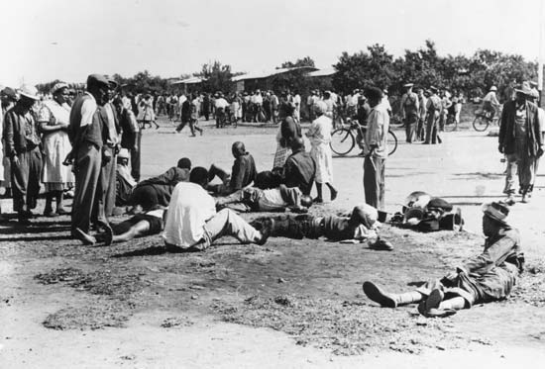
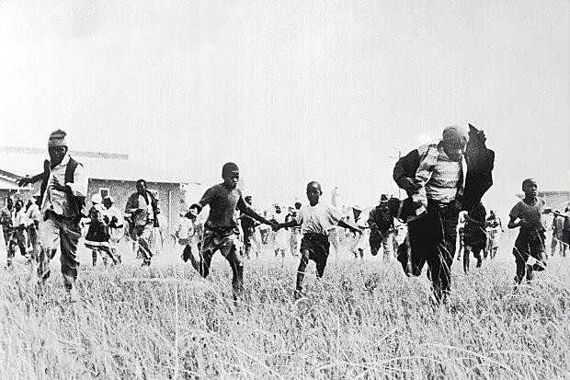
© 2014 Brain Wrinkles

Slide 19
Imprisoned
In 1962, Mandela was captured and accused of sabotage and plotting to overthrow the government.
In 1964, at the age of 46, he was found guilty and sentenced to life in prison.
Mandela was sent to prison on Robben Island.
There, he had to do hard labor and was allowed one visitor every six months.
© 2014 Brain Wrinkles

Slide 20
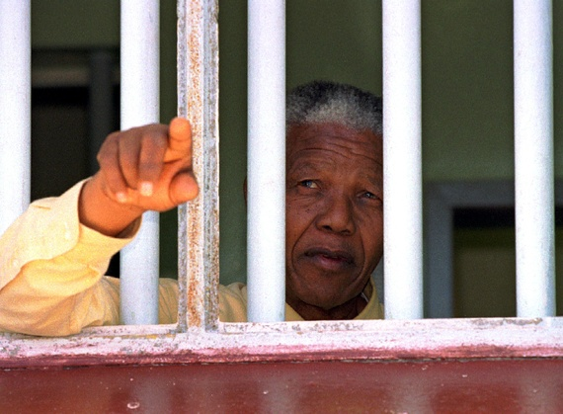
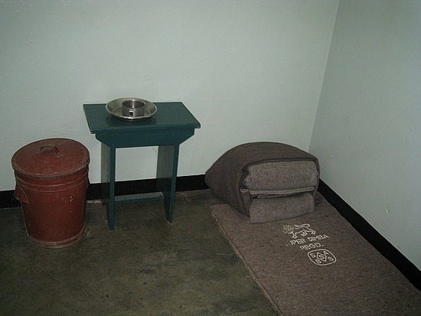
© 2014 Brain Wrinkles

Slide 21
F.W. de Klerk
In 1989, F.W. de Klerk became president of South Africa and began to dismantle the apartheid system.
Almost immediately, de Klerk ended apartheid and freed Nelson Mandela.
In 1990, Mandela was pardoned by de Klerk and became a free man after serving 27 years in prison.
© 2014 Brain Wrinkles

Slide 22
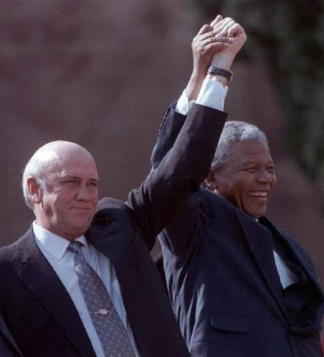
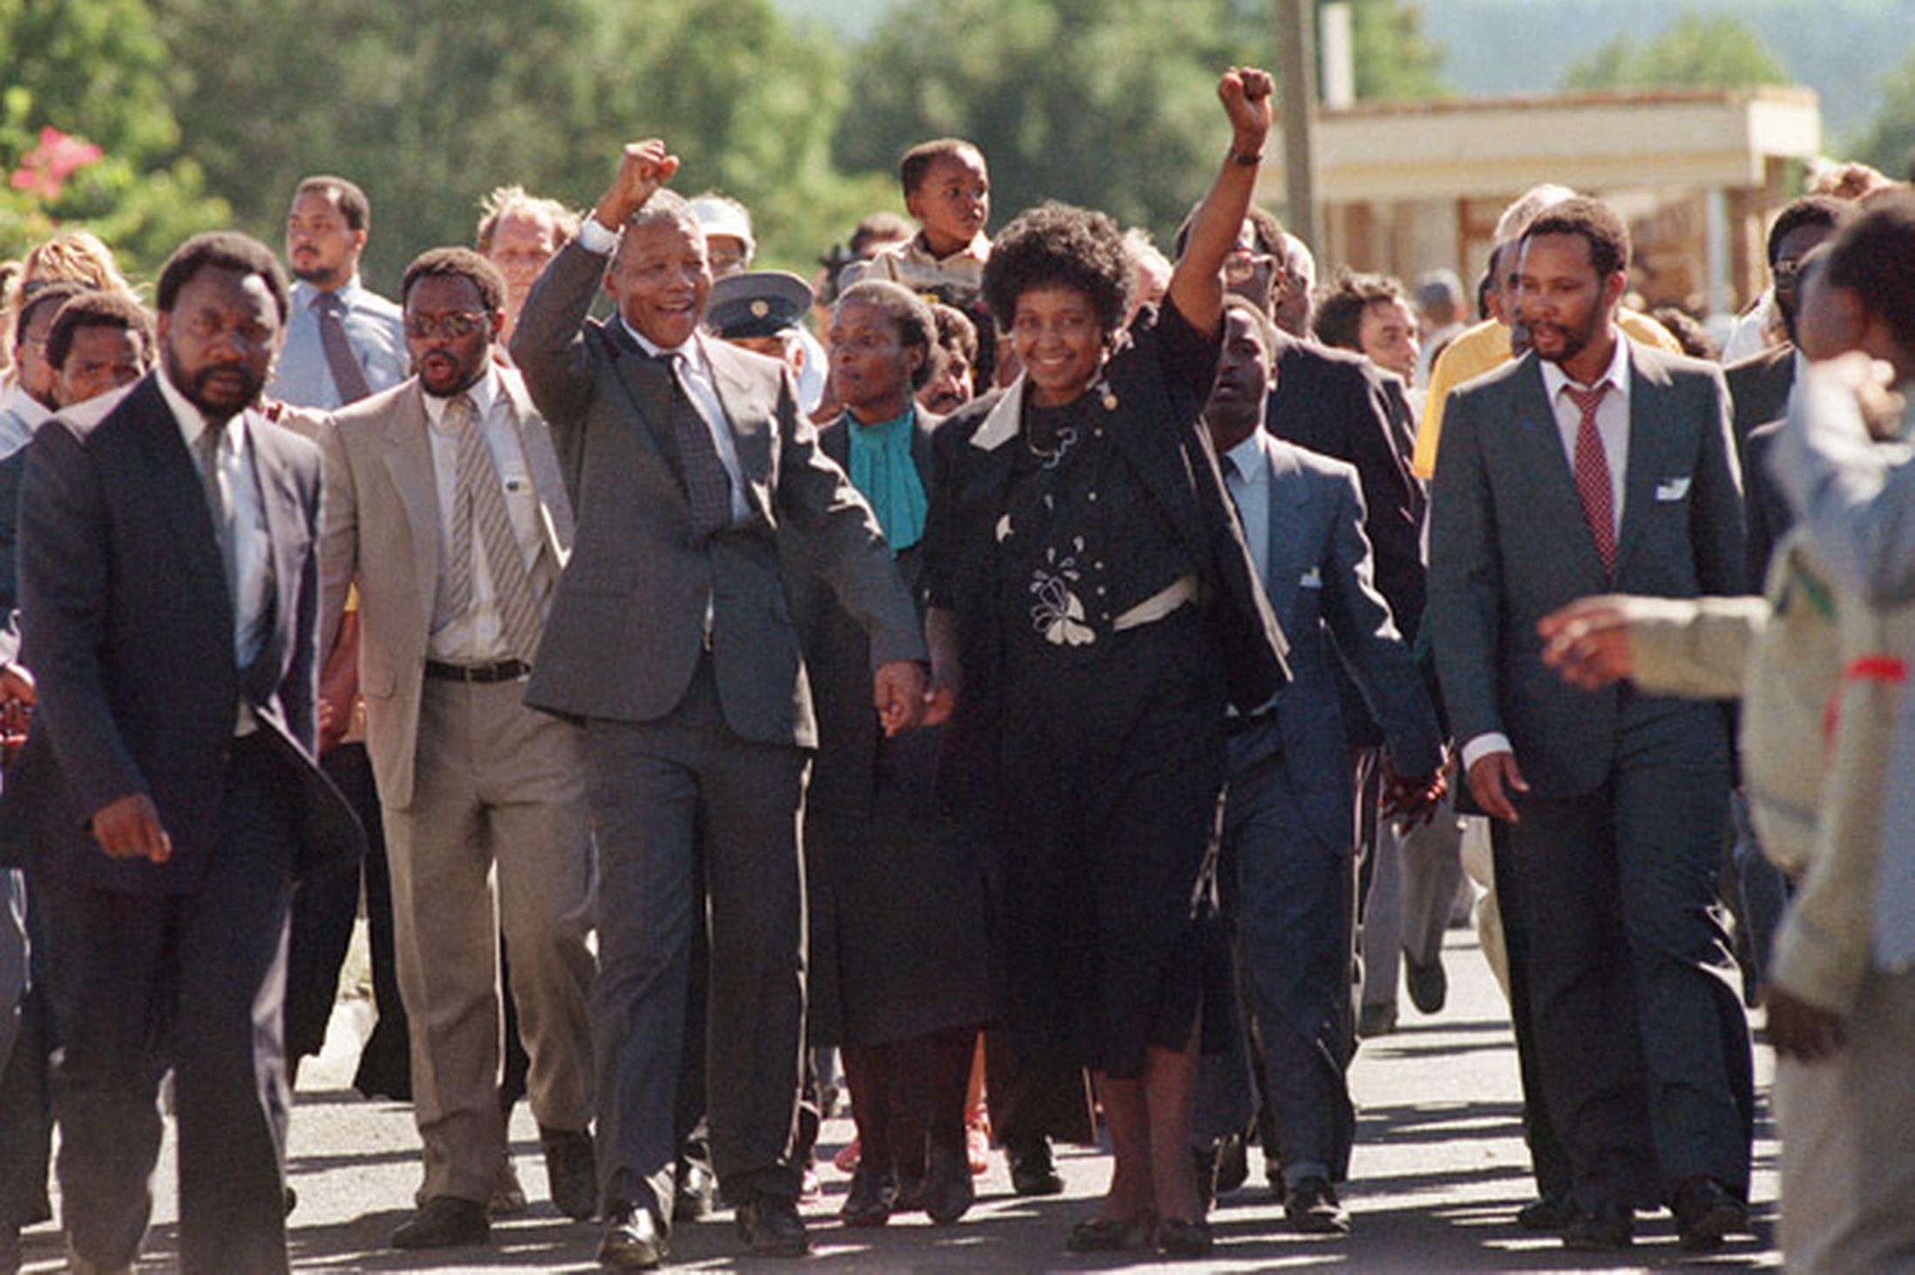
De Klerk and Mandela
Mandela Released from Prison
© 2014 Brain Wrinkles

Slide 23
The End
President de Klerk worked from within the government to end apartheid, while Mandela resumed his position as president of the ANC, and worked to end apartheid from the outside.
In 1993, de Klerk and Mandela shared the Nobel Peace Prize for moving the country peacefully to a nonracial democracy.
In 1994, South Africa held its first election open to all races.
Nelson Mandela was elected the first black president of South Africa.
© 2014 Brain Wrinkles

Slide 24
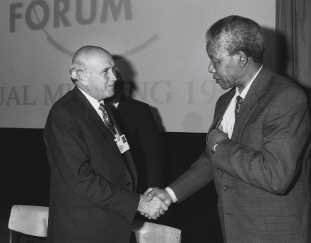
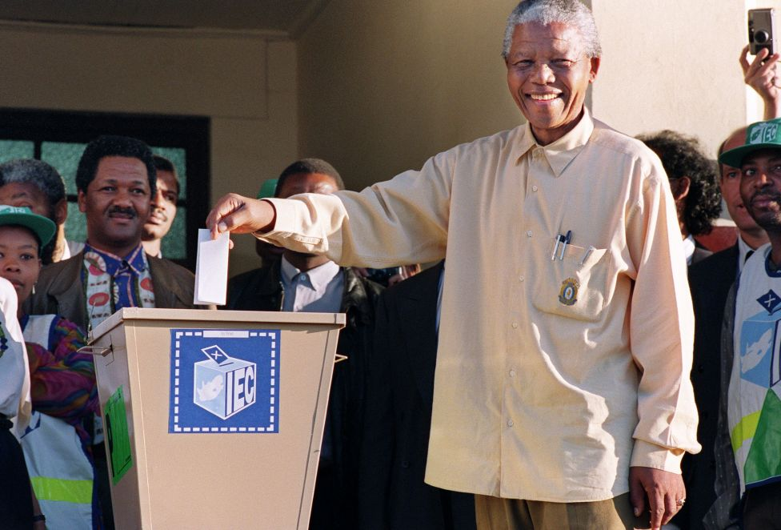
De Klerk and Mandela, 1992
Mandela Voting, 1994
© 2014 Brain Wrinkles

Slide 25
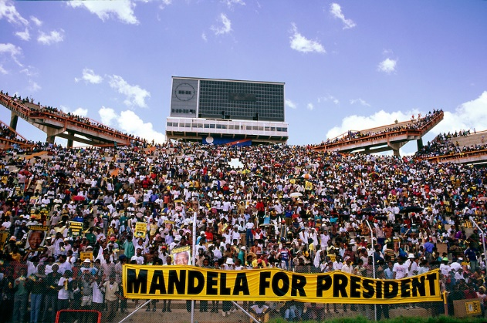
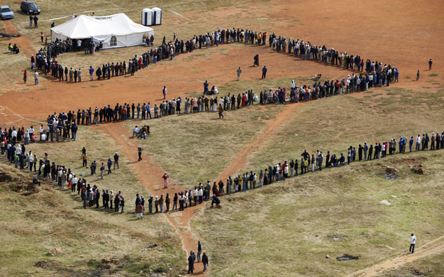
Waiting in line to vote, 1994
© 2014 Brain Wrinkles

Slide 26
Today…
Despite having a stable democratic government and the strongest economy in Africa, South Africa still has major issues.
There is still economic inequality and poverty throughout the country.
Most of the wealth is concentrated in predominately white urban areas.
The rural areas where blacks are predominate are still terribly poor.
© 2014 Brain Wrinkles

Slide 27
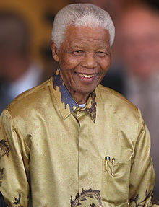
Nelson Mandela
July 18, 1918 – December 5, 2013
© 2014 Brain Wrinkles

