Slide 1
The Impact of
Communism
in China
Mao Zedong, Great Leap Forward, Cultural Revolution, & Tiananmen Square

Slide 2
Standards
SS7H3 The student will analyze continuity and change in Southern and Eastern Asia leading to the 21st century.
d. Describe the impact of Communism in China in terms of Mao Zedong, the Great Leap Forward, the Cultural Revolution, and Tiananmen Square.

Slide 3
Nationalism
In 1911, a group of nationalists had taken over China.
The Chinese Nationalist Party was able to overthrow the Qing Dynasty, which had been in power since the 1600s.
Unfortunately, the new government was failing to provide for the Chinese people and many were living in poverty.
Many Chinese were angry and became interested in the Communist Revolution in Russia.

Slide 4
Communist Party
In 1921, a group of young men met in Shanghai to form the first Chinese Communist Party, headed by Mao Zedong.
The party promised to improve peasants’ living conditions and won the support of many Chinese people.
A civil war soon began between the Nationalists and Mao’s communist followers.
In 1933, Mao led over 600,000 people on the Long March through the mountains for over 6,000 miles to avoid being captured by the nationalist government.

Slide 5
"Revolution is not a dinner party, nor an essay, nor a painting, nor a piece of embroidery; it cannot be so refined, so leisurely and gentle, so temperate, kind, courteous, restrained and magnanimous. A revolution is an insurrection, an act of violence by which one class overthrows another.”
~Mao Zedong 1927

Slide 6
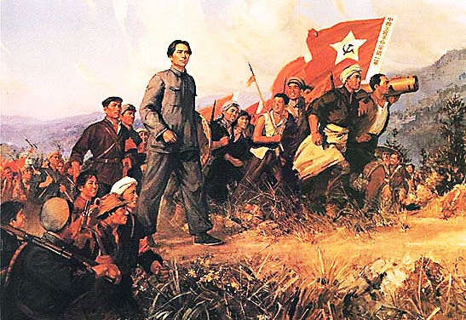
The Long March
Mao Zedong 1935

Slide 7
People’s Republic
The Communists and Nationalists had to call a truce during WWII as both were fighting to keep the Japanese out of China.
The civil war continued from 1946 to 1949, until the Communists, now called the Red Army, took control of China’s government.
On October 1, 1949, Mao declared the creation of the People’s Republic of China, a communist country.
Mao was appointed head of China’s government and had almost complete control over China.
He became popular with many Chinese people when he took land from wealthy citizens and gave it to peasants.
He wanted to improve living conditions for the poor.

Slide 8
Mao Zedong declares the founding of the People's Republic of China on October 1st, 1949.

Slide 9
Great Leap Forward
Mao implemented a program in 1958 to organize all farms into collectives where large communes of about 25,000 people farmed together under government supervision.
He believed this would speed China’s economic development, so the program was called the Great Leap Forward.
The Great Leap Forward was a disaster.
Chinese farmers did not like the government making all of the decisions and, because they no longer owned the land, they had little reason to work hard.
Droughts and floods damaged the food supply that year and made things even worse.
As a result, about 20 million people died from 1958 to 1960 during one of the largest famines in history.

Slide 10
Women working together during the Great Leap Forward.

Slide 11
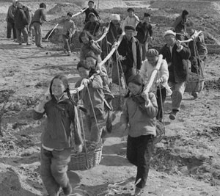
Collective Farming 1959

Slide 12
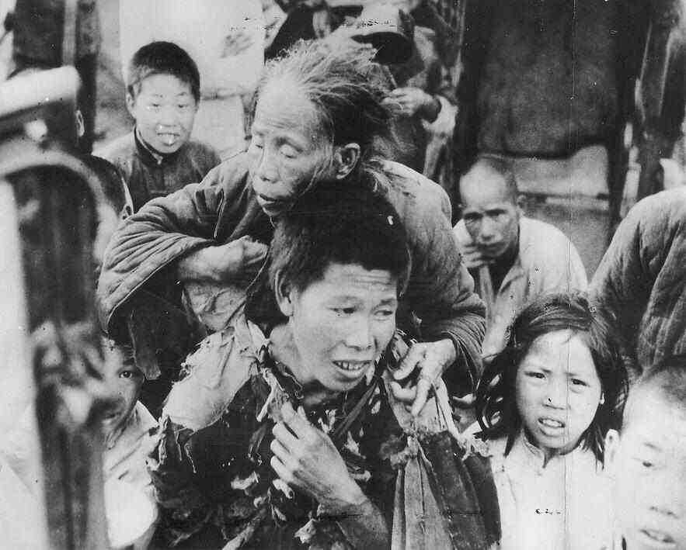
The Great Famine

Slide 13
Cultural Revolution
video
The failures of the Great Leap forward made many Chinese lose confidence in Mao’s leadership.
In response, Mao created the Cultural Revolution in 1966 to stop all opposition to the Chinese Communist Party.
He urged students to quit school and wage war on anyone who opposed communism.
The students were organized into an army known as the Red Guards.
They attacked, imprisoned, and even killed those suspected of not agreeing with Mao.
The Cultural Revolution created mass chaos in China for almost 10 years.
Many schools and factories were closed, and people were denied healthcare and transportation by the government.

Slide 14
Cover of an elementary school textbook – image shows 3 young Red Guards.

Slide 15
“Destroy the Old World”
Cultural Revolution Propaganda Poster 1967

Slide 16
Cultural Revolution Propaganda Poster

Slide 17
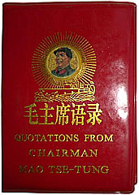
Mao’s The Little Red Book
This was a collection of excerpts from past speeches and publications. It was required for citizens to read, memorize, and carry this with them at all times.

Slide 18
New Leader
Mao Zedong died in 1976 and the Cultural Revolution finally ended.
China’s new leader, Deng Xiaoping, made many reforms to Mao’s rules, but the government still stuck to its communist roots.
He began to allow farmers to own their own land and to make decisions about what they should grow.
He allowed some private businesses to open.
He opened China to foreign investments.
Unfortunately, the Chinese people were still not given basic human rights like freedom of speech and religion or the right to a fair trial.

Slide 19
Tiananmen Square
In 1989, communist governments were under siege in numerous places around the world.
Over 10,000 Chinese students gathered to protest China’s corrupt communist government in Beijing’s Tiananmen Square.
They filled the square for seven weeks, peacefully speaking against communism and calling for a move toward democracy in China.
On June 4, 1989, the Chinese government sent soldiers and tanks into the square, killing hundreds of innocent people.
Countries around the world condemned this violence and began urging China to improve the human rights of its citizens.

Slide 20
Tiananmen Square, Beijing 1988

Slide 21
1989

Slide 22
Tanks Rolling In…

Slide 23
