Slide 1
The Impact of
Communism
in China
Mao Zedong, Great Leap Forward, Cultural Revolution, & Tiananmen Square

Slide 2
Standards
SS7H3 The student will analyze continuity and change in Southern and Eastern Asia leading to the 21st century.
d. Describe the impact of Communism in China in terms of Mao Zedong, the Great Leap Forward, the Cultural Revolution, and Tiananmen Square.

Slide 3
The Impact of
Communism
in China
Mao Zedong, Great Leap Forward, Cultural Revolution, & Tiananmen Square

Slide 4
Nationalism
In 1911, a group of nationalists had taken over China.
The Chinese Nationalist Party was able to overthrow the Qing Dynasty, which had been in power since the 1600s.
Unfortunately, the new government was failing to provide for the Chinese people and many were living in poverty.
Many Chinese were angry and became interested in the Communist Revolution in Russia.

Slide 5
Communist Party
In 1921, a group of young men met in Shanghai to form the first Chinese Communist Party, headed by Mao Zedong.
The party promised to improve peasants’ living conditions and won the support of many Chinese people.
A civil war soon began between the Nationalists and Mao’s communist followers.
In 1933, Mao led over 600,000 people on the Long March through the mountains for over 6,000 miles to avoid being captured by the nationalist government.

Slide 6
"Revolution is not a dinner party, nor an essay, nor a painting, nor a piece of embroidery; it cannot be so refined, so leisurely and gentle, so temperate, kind, courteous, restrained and magnanimous. A revolution is an insurrection, an act of violence by which one class overthrows another.”
~Mao Zedong 1927

Slide 7
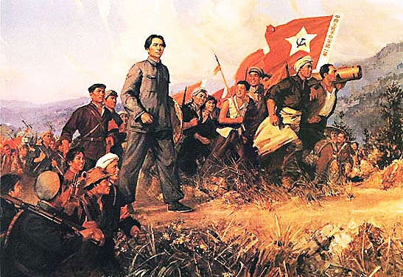
The Long March
Mao Zedong 1935

Slide 8
People’s Republic
The Communists and Nationalists had to call a truce during WWII as both were fighting to keep the Japanese out of China.
The civil war continued from 1946 to 1949, until the Communists, now called the Red Army, took control of China’s government.
On October 1, 1949, Mao declared the creation of the People’s Republic of China, a communist country.
Mao was appointed head of China’s government and had almost complete control over China.
He became popular with many Chinese people when he took land from wealthy citizens and gave it to peasants.
He wanted to improve living conditions for the poor.

Slide 9
Mao Zedong declares the founding of the People's Republic of China on October 1st, 1949.

Slide 10
Great Leap Forward
Mao implemented a program in 1958 to organize all farms into collectives where large communes of about 25,000 people farmed together under government supervision.
He believed this would speed China’s economic development, so the program was called the Great Leap Forward.
The Great Leap Forward was a disaster.
Chinese farmers did not like the government making all of the decisions and, because they no longer owned the land, they had little reason to work hard.
Droughts and floods damaged the food supply that year and made things even worse.
As a result, about 20 million people died from 1958 to 1960 during one of the largest famines in history. Video

Slide 11
Women working together during the Great Leap Forward.

Slide 12
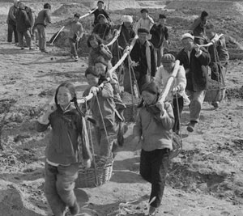
Collective Farming 1959

Slide 13
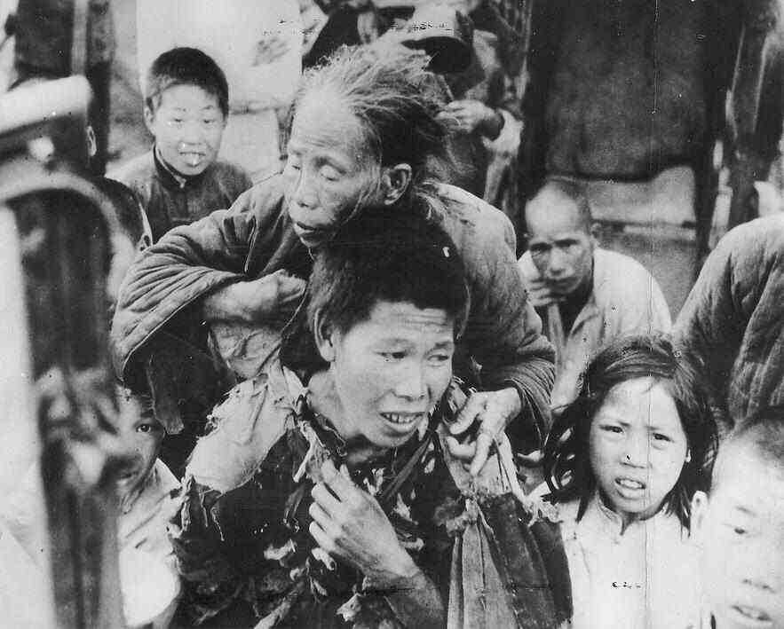
The Great Famine

Slide 14
Cultural Revolution
The failures of the Great Leap forward made many Chinese lose confidence in Mao’s leadership.
In response, Map created the Cultural Revolution in 1966 to stop all opposition to the Chinese Communist Party.
He urged students to quit school and wage war on anyone who opposed communism.
The students were organized into an army known as the Red Guards.
They attacked, imprisoned, and even killed those suspected of not agreeing with Mao.
The Cultural Revolution created mass chaos in China for almost 10 years.
Many schools and factories were closed, and people were denied healthcare and transportation by the government. Video

Slide 15
Little Red Book
The Little Red Book also known as Quotations from Chairman Mao Zedong (毛主席语录) has been published by the government of the People’s Republic of China since 1964.
It is a collection of quotations excerpted from Mao Zedong's past speeches and publications.
900 million copies of The Little Red Book have been sold--second only to the Bible which has been around much longer.
It was essentially an unofficial requirement for every Chinese citizen to own, to read, and to carry it at all times during the Cultural Revolution.
The punishment for failing to produce the book upon being asked would range from being beaten by Red Guards to being given years of hard-labor imprisonment.
Studying the book was required in schools, as well as at workplaces. Workplaces have specified reading sessions during working hours for workers to study the book.

Slide 16
Cover of an elementary school textbook – image shows 3 young Red Guards.

Slide 17
“Destroy the Old World”
Cultural Revolution Propaganda Poster 1967

Slide 18
Cultural Revolution Propaganda Poster

Slide 19
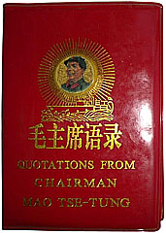
Mao’s The Little Red Book
This was a collection of excerpts from past speeches and publications. It was required for citizens to read, memorize, and carry this with them at all times.

Slide 20
New Leader
Mao Zedong died in 1976 and the Cultural Revolution finally ended.
China’s new leader, Deng Xiaoping, made many reforms to Mao’s rules, but the government still stuck to its communist roots.
He began to allow farmers to own their own land and to make decisions about what they should grow.
He allowed some private businesses to open.
He opened China to foreign investments.
Unfortunately, the Chinese people were still not given basic human rights like freedom of speech and religion or the right to a fair trial.

Slide 21
Tiananmen Square
In 1989, communist governments were under siege in numerous places around the world.
Over 10,000 Chinese students gathered to protest China’s corrupt communist government in Beijing’s Tiananmen Square.
They filled the square for seven weeks, peacefully speaking against communism and calling for a move toward democracy in China.
On June 4, 1989, the Chinese government sent soldiers and tanks into the square, killing hundreds of innocent people.
Countries around the world condemned this violence and began urging China to improve the human rights of its citizens.

Slide 22
Tiananmen Square, Beijing 1988

Slide 23
1989

Slide 24
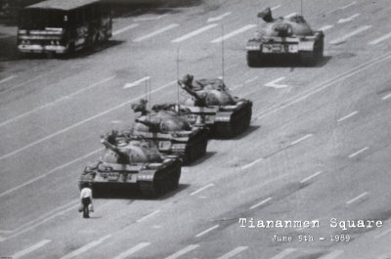
Tanks Rolling In…
Video

Slide 25
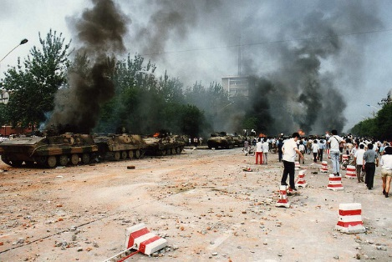
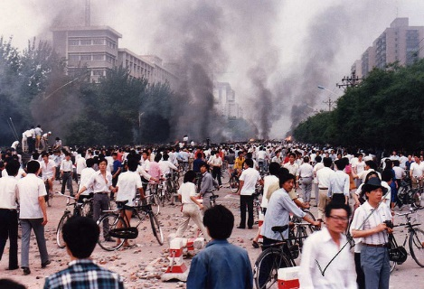

Slide 26
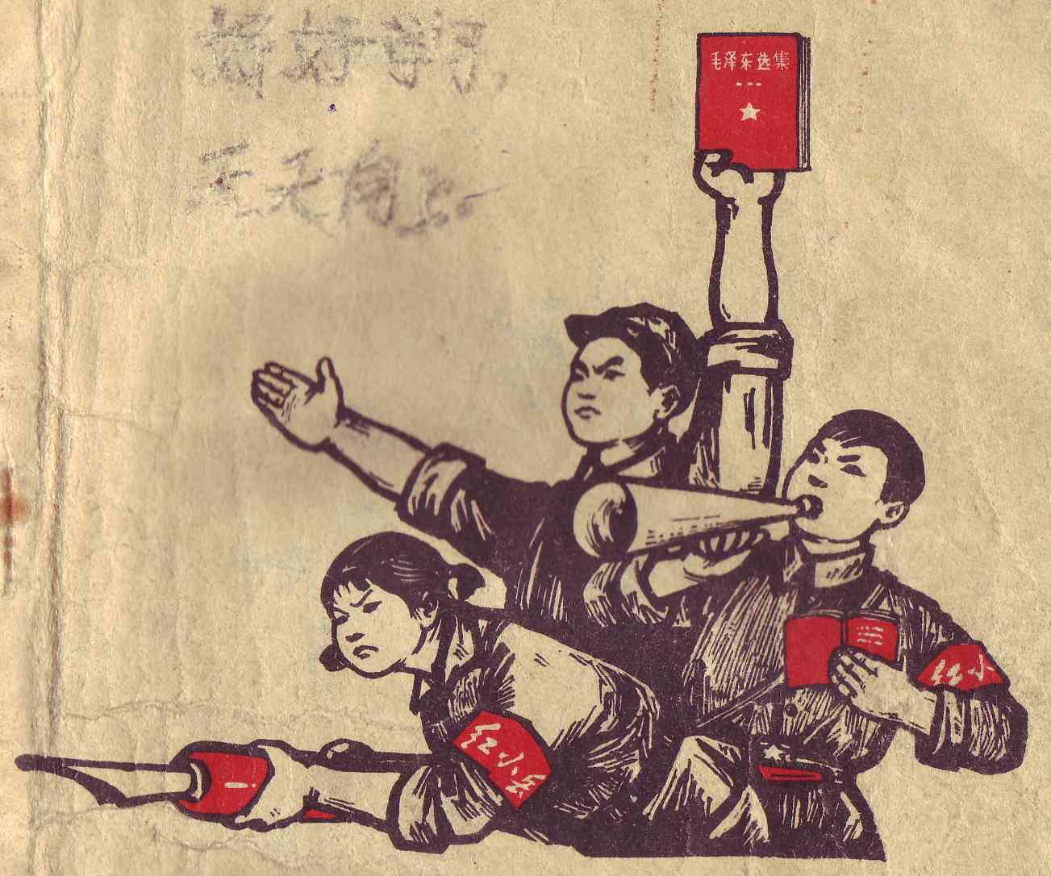
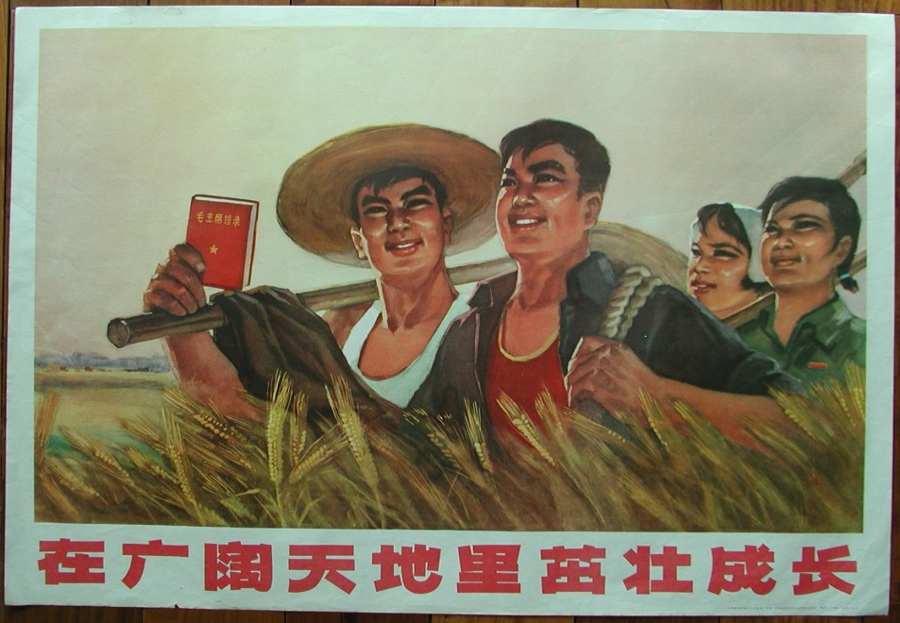
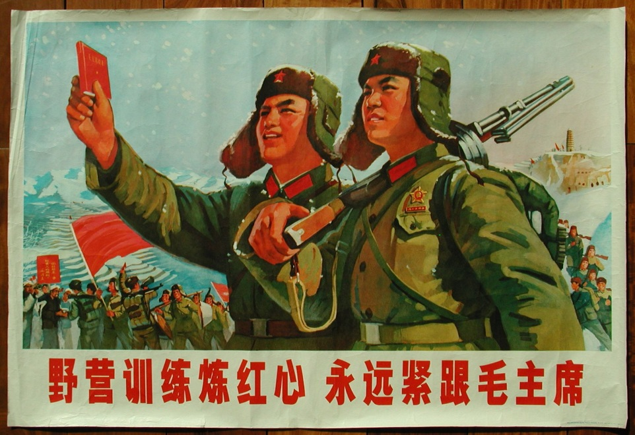
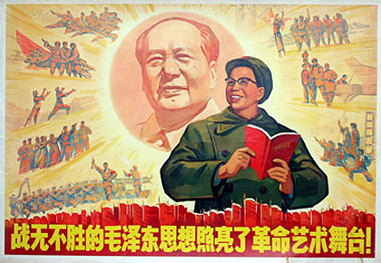
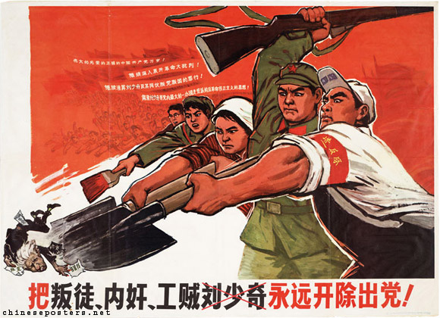

Slide 27
