Slide 1
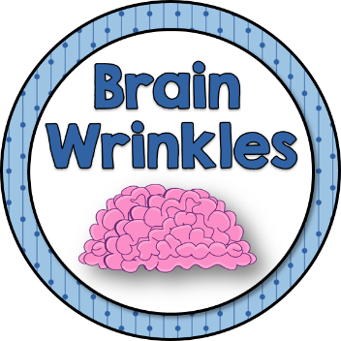
SS7H3e
Containment
of
Communism
Korea & Vietnam
© 2015 Brain Wrinkles

Slide 2
End of WWII
The United States, Soviet Union, and Great Britain made an agreement on how they would put the world back together after World War II.
Each country was supposed to temporarily occupy the lands that were impacted by the war.
They would work to restore order and free elections would be held so that they people could decide on their future government.
© 2015 Brain Wrinkles

Slide 3
Soviet Union
Once peace was declared, the Soviet Union found itself reluctant to leave its occupied countries.
The Soviet Union worked hard to be sure that the new governments were communist.
It eventually began to take over Eastern European and Asian countries by force in order to spread this form of government.
© 2015 Brain Wrinkles

Slide 4
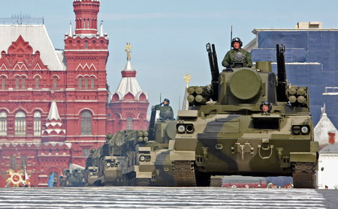
© 2014 Brain Wrinkles

Slide 5
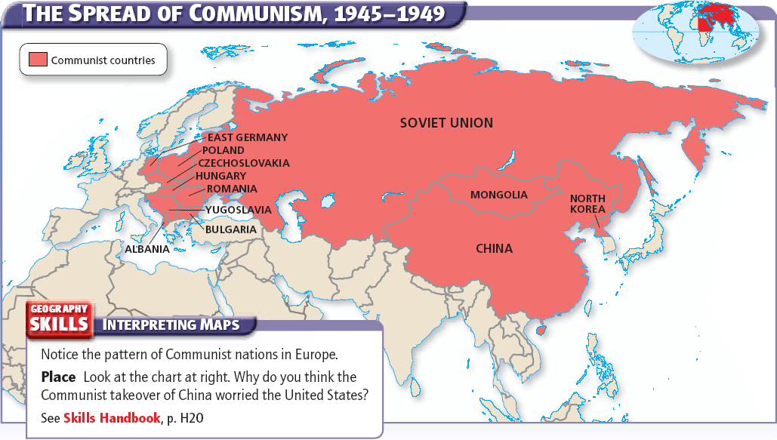
© 2014 Brain Wrinkles

Slide 6
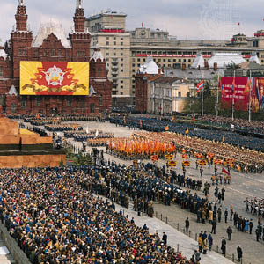
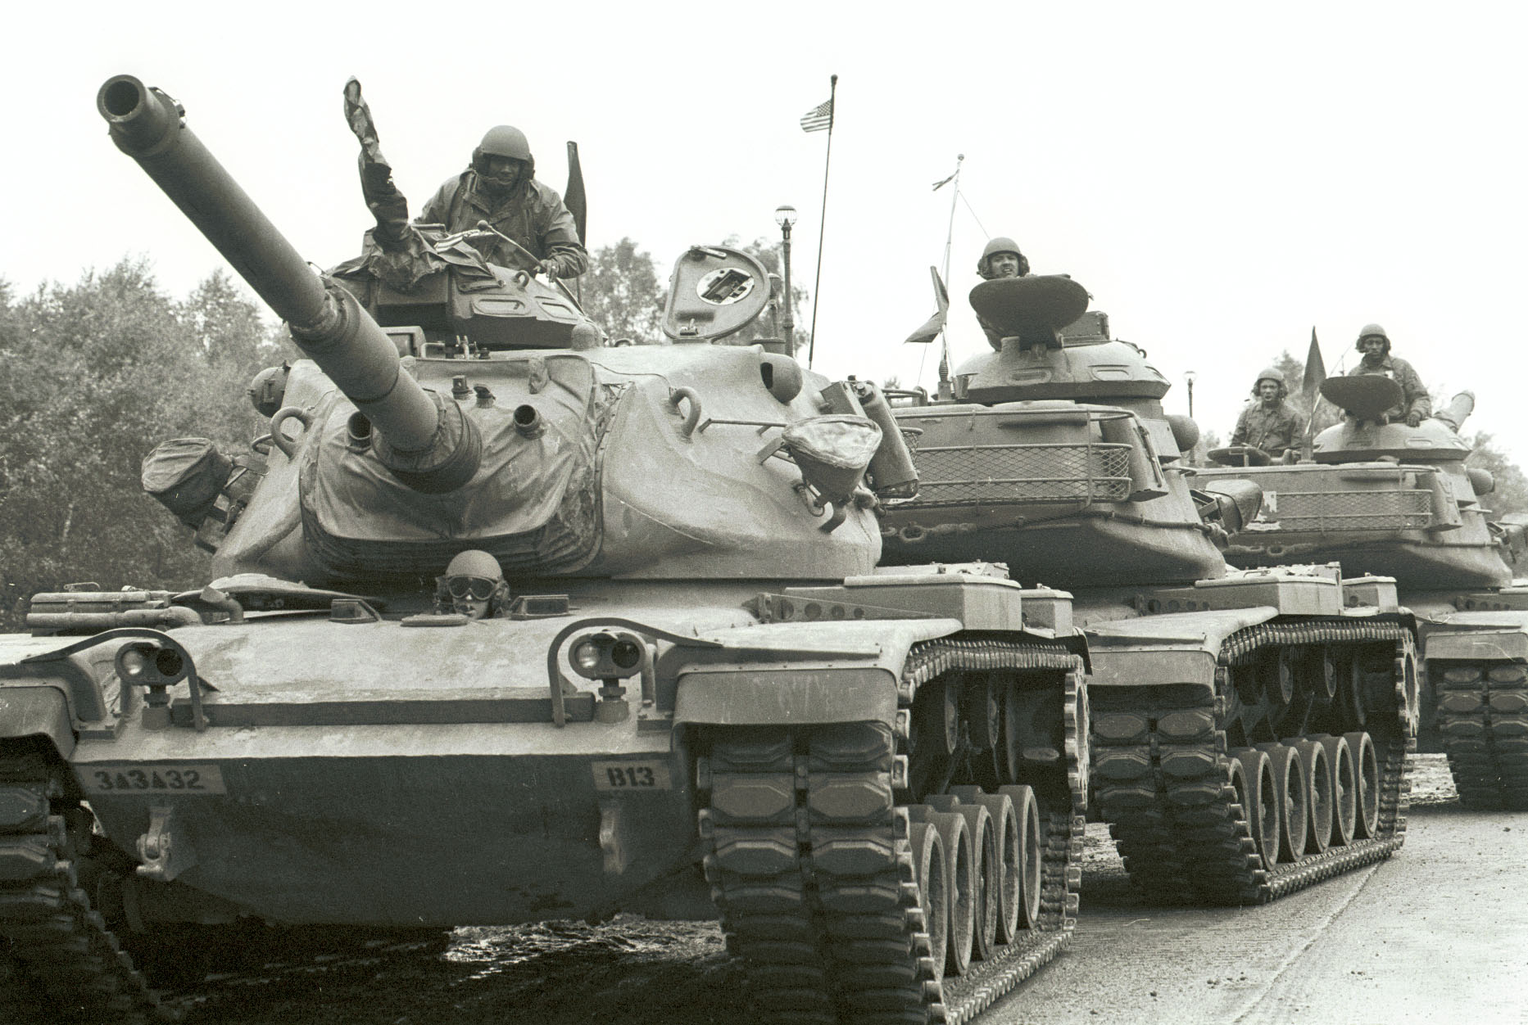
© 2015 Brain Wrinkles

Slide 7
United States
The United States was furious and saw this as breaking the promises made after WWII.
The US offered aid to the countries threatened by the Soviets so that they could protect their individual rights.
The US and the Soviet Union found themselves engaged in a Cold War, where they competed to become the dominating world power.
© 2015 Brain Wrinkles

Slide 8
Post-WWII Korea
One place where this struggle was seen was on the Korean peninsula.
After World War II, Japanese-occupied Korea was temporarily divided into northern and southern parts.
The Soviet Union controlled Korea north of the 38th parallel and established a communist government.
The United States would be in charge of Korea south of the 38th parallel and promoted a democratic system.
© 2015 Brain Wrinkles

Slide 9
Korean War
In 1950, Kim Il Sung, the leader of North Korea, sent his powerful army to invade South Korea.
The US had to take a stand against Communist aggression and was willing to go to war to keep communism from spreading to this area.
US President Truman ordered American naval and air forces to support Korean ground troops, and asked the United Nations to approve the use of force to stop the North Korean invasion.
© 2015 Brain Wrinkles

Slide 10
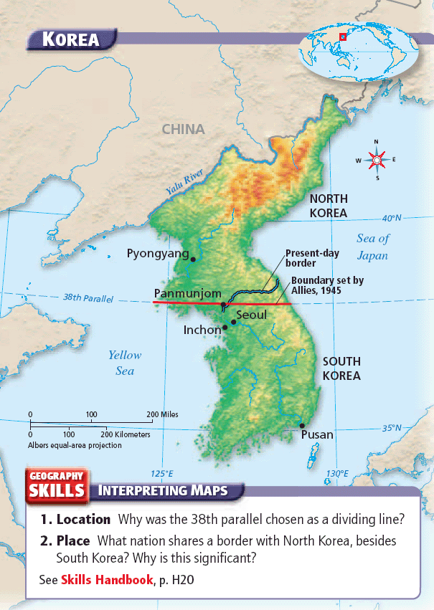
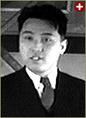
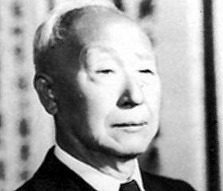
Kim Il-Sung
Syngman Rhee
© 2015 Brain Wrinkles

Slide 11
Korean War
The United Nations responded quickly, imposing military sanctions. The U.S. and 19 other nations committed troops to the area.
The UN force, commanded by American General Douglas MacArthur, forced Korean soldiers out of South Korea and farther north to the Chinese border.
Despite initial heavy losses, the combined UN forces finally began to win.
© 2015 Brain Wrinkles

Slide 12
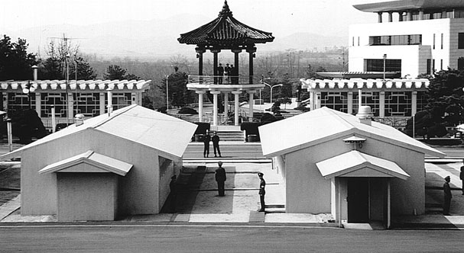

Slide 13
Korean War
Going beyond the 38th parallel into North Korea brought communist China’s well-trained and well-equipped army into the war.
The Communist Chinese attacked, forcing the UN soldiers to retreat.
When the fighting finally ended in 1953, no one was truly victorious (stalemate).
The 38th parallel dividing line remained intact between the two countries.
© 2015 Brain Wrinkles

Slide 14
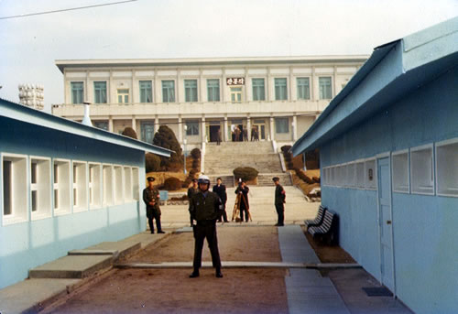
© 2015 Brain Wrinkles

Slide 15
Korea Today
The Korean peninsula was badly damaged, and many lives were lost.
South Korea remained “free”, so containment of communism had worked.
Today, South Korea has free elections and a democratic constitution.
North Korea remains a communist country under the autocratic rule of Premiere Kim Jong-Un.
© 2015 Brain Wrinkles

Slide 16
Vietnam
Vietnam was also caught in the fight to contain communism.
The country was divided into two parts in 1954.
Ho Chi Minh’s communists led North Vietnam, while the United States provided military support to keep South Vietnam from falling to the Communists.
The United States did not want any new communist countries formed in Southeast Asia.
© 2015 Brain Wrinkles

Slide 17
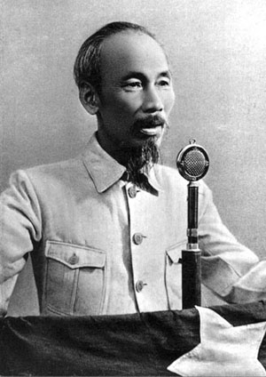
Ho Chi Minh
Leader of North Vietnam
© 2015 Brain Wrinkles

Slide 18
Vietnam War
In 1965, the US became involved in the Vietnam War when it began bombing North Vietnam.
Billions of dollars were spent and thousands of lives were lost fighting in Vietnam to prevent the country from becoming communist.
Many Americans protested US involvement, and in 1973, US troops were withdrawn.
The Vietnam War ended in a cease-fire.
© 2015 Brain Wrinkles

Slide 19
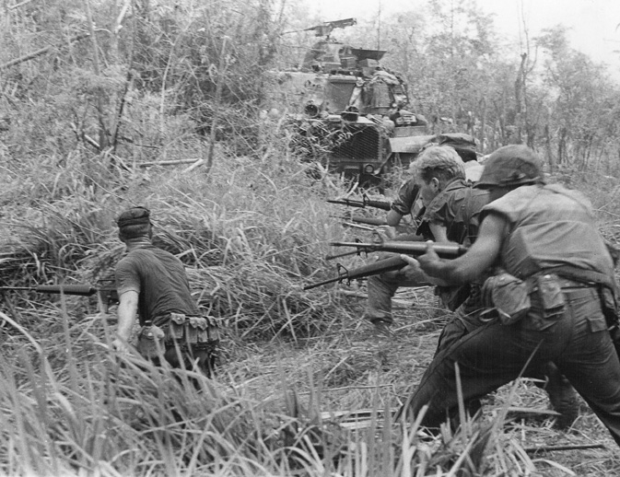
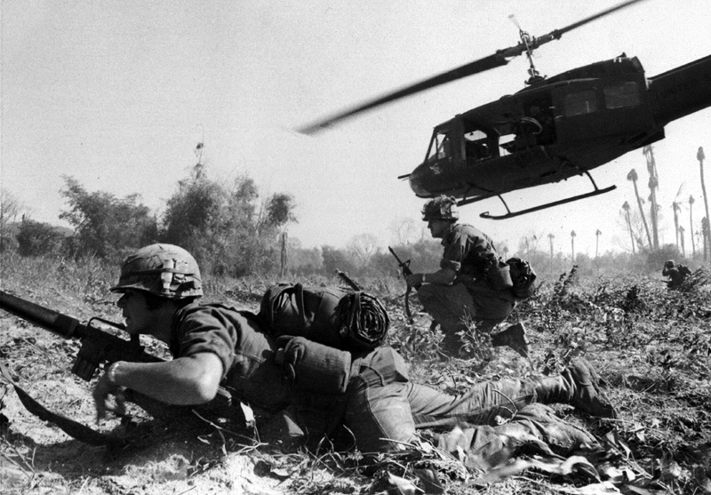
© 2015 Brain Wrinkles

Slide 20
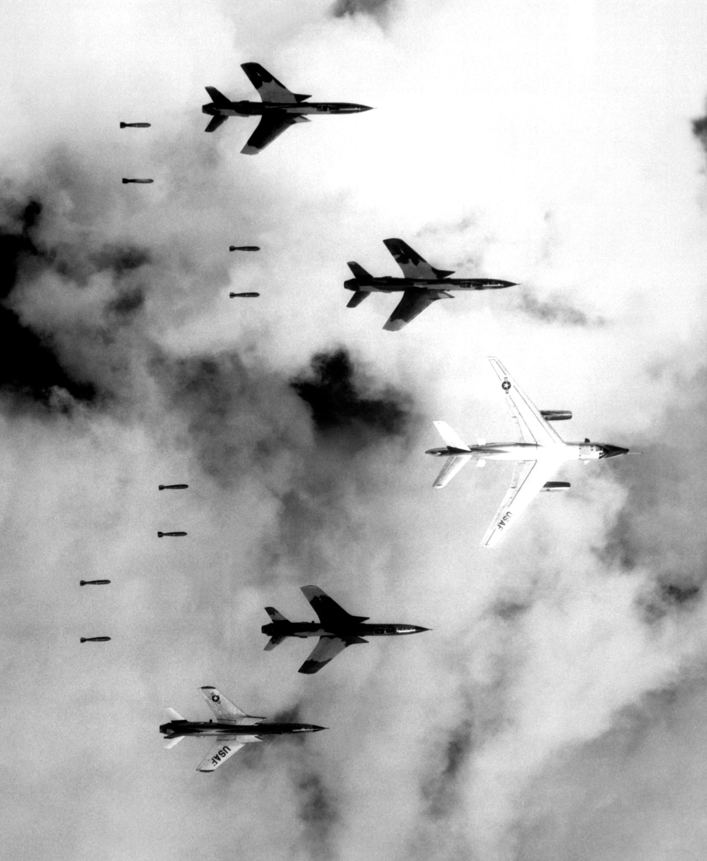
A US B-66 Destroyer and four F-105 Thunderchiefs dropping bombs on North Vietnam.
© 2015 Brain Wrinkles

Slide 21
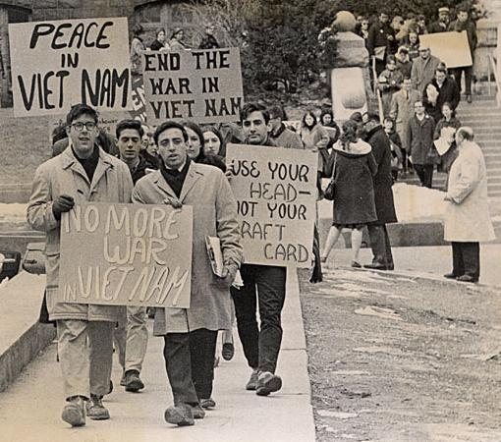
Student Protestors in Wisconsin - 1965
© 2015 Brain Wrinkles

Slide 22
Vietnam Today
In 1975, North Vietnam took over South Vietnam for good and the country was reunited as one.
The People’s Republic of Vietnam was declared a communist country.
© 2015 Brain Wrinkles

Slide 23
Democracy
In order to protect democracy and citizens’ individual freedoms and rights, the US intervened in both Korea and Vietnam to fight against communism.
Today, South Korea has a democratic republic similar to that of the US, while Vietnam is a communist nation.
Although there are still a few communist countries left in the world today, the US successfully contained the spread of communism.
© 2015 Brain Wrinkles

