Slide 1
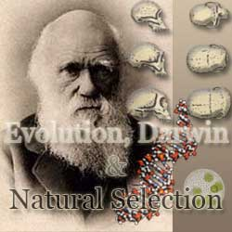
Sect. 6.1

Slide 2
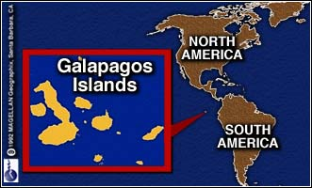
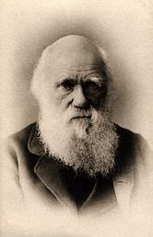
1. Charles Darwin (1809-1882) Sailed around the world 1831-1836

Slide 3
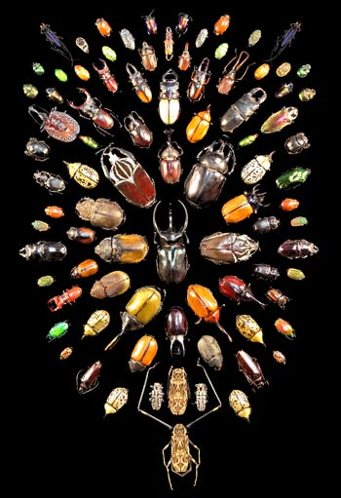
2. What did Darwin’s Travels reveal
The diversity of living species was far greater than anyone had previously known!!
These observations led him to develop the theory of evolution!!

Slide 4
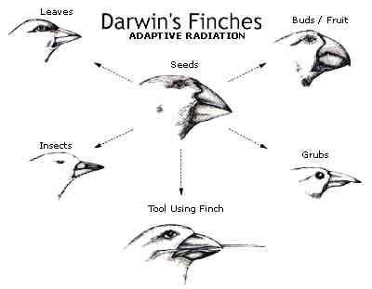
3.How did tortoises and birds differ among the islands of the Galapagos?
Each island had its own type of tortoises and birds that were clearly different from other islands

Slide 5
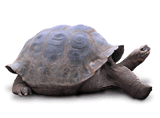
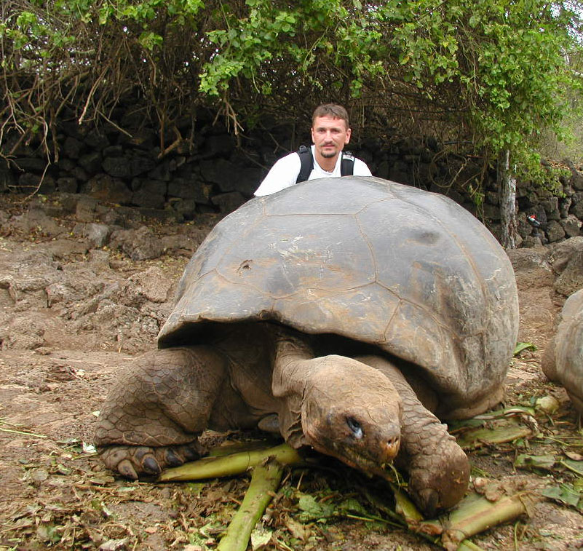
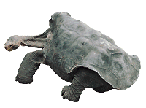
Galapagos Turtles

Slide 6
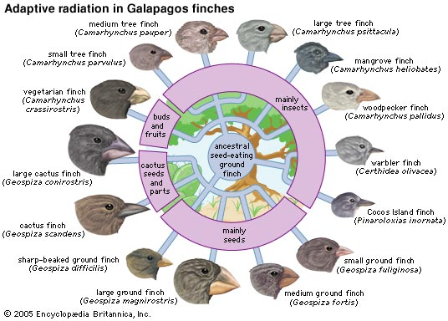
4. Evolution is when organisms change over time. So, modern organisms descended from ancient ones

Slide 7
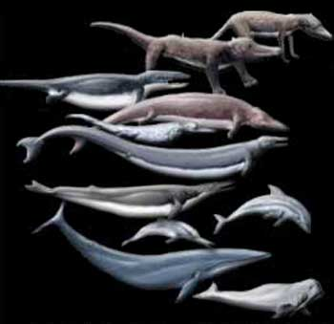
7. Evolution is a Theory –
Evolution is a well supported explanation of phenomena that have occurred in the natural world
A theory in science is a well tested hypothesis, not just a guess

Slide 8
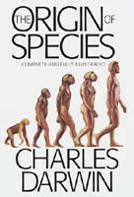
8. Darwin finally published his ideas in 1859
Other naturalists were developing the same theory that Darwin did.
Even though he was afraid of the Church’s reaction to his book he wanted to get credit for his work.

Slide 9
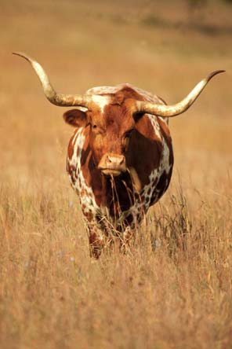
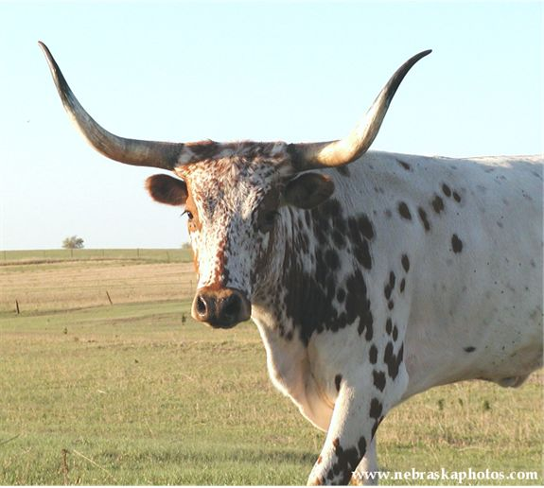
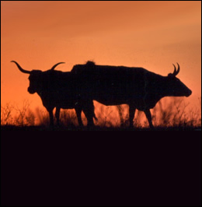
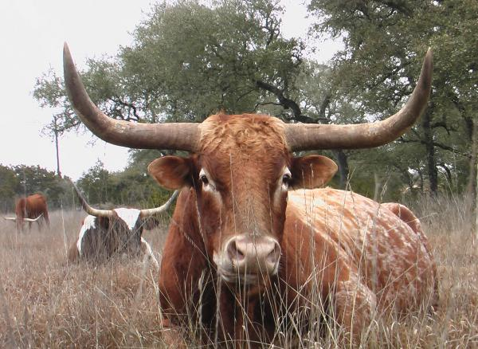
9. Artificial Selection
nature provides variation, humans select variations that are useful.
Example - a farmer breeds only his best livestock

Slide 10
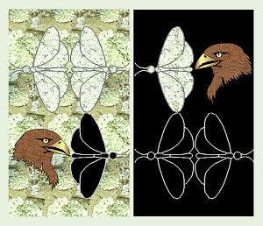
10. Natural Selection
The traits that help an organism survive in a particular environment are “selected” in natural selection

Slide 11
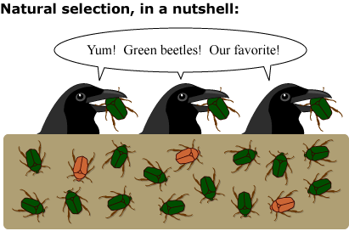

Slide 12
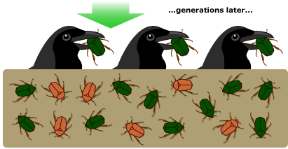

Slide 13
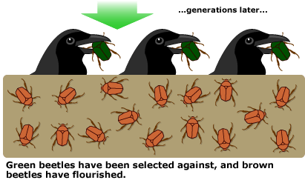

Slide 14
11. Natural Selection and Species Fitness
Overtime, natural selection results in changes in the inherited characteristics of a population.
These changes increase a species fitness (survival rate)

Slide 15
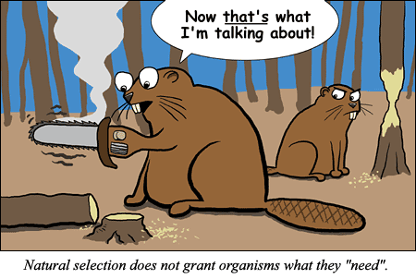

Slide 16
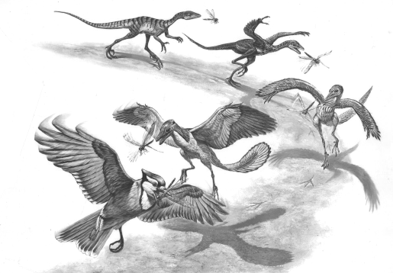
Descent with Modification
Each living species has descended with changes from other species over time

Slide 17
Summary of Darwin’s Theory
1. Organisms differ; variation is inherited
2. Organisms produce more offspring than survive
3. Organisms compete for resources
4. Organisms with advantages survive to pass those advantages to their children
5. Species alive today are descended with modifications from common ancestors

Slide 18
13. Evidence of Evolution
Fossil Record
Geographic Distribution of Living Species
Homologous Body structures
Similarities in Embryology

Slide 19
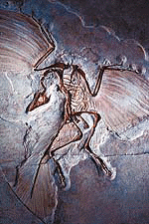
Evidence of Evolution
Fossil Record provides evidence that living things have evolved
Fossils show the history of life on earth and how different groups of organisms have changed over time

