Slide 1
Location, Location, Location
How Southern and Eastern Asian citizens live, work, and travel.

Slide 2
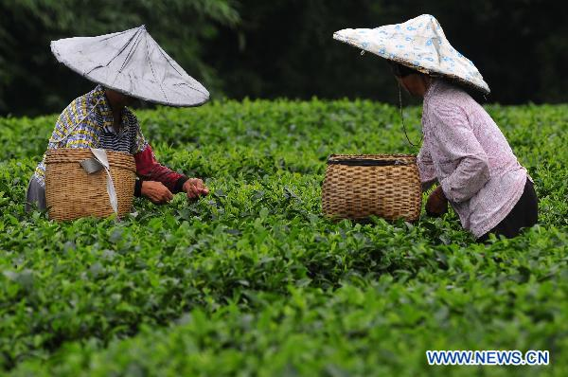
Lots and Lots of people
More than 1/3 of all the people in the world live in China and India!
Most Asians live in rural areas, farming the land to provide food for their families.
About 90% of China’s people are concentrated in the plateaus, plains, and river valleys of the eastern third of the country where fertile soil and plentiful rain are found.
Close to 75% of India’s population lives in more than 500,000 villages.
Since about 50% of India’s land is arable (land that is suitable for growing), most Indians work in agriculture.

Slide 3
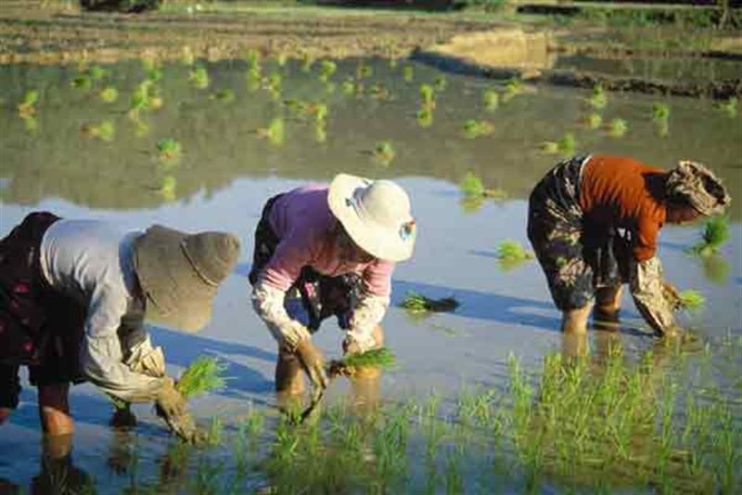
Lots and Lots of people
About ½ of Vietnam’s people are farmers, living in the fertile deltas of the Mekong and Red Rivers and growing rice, coffee, fruits, and vegetables.
In Thailand, people live around fertile river areas to grow rice and other crops.
Even in highly industrialized Japan, most of the people live where the largest cities are.
In the mountains of China and Japan, the population is much lower as is the population in China’s desert areas.

Slide 4
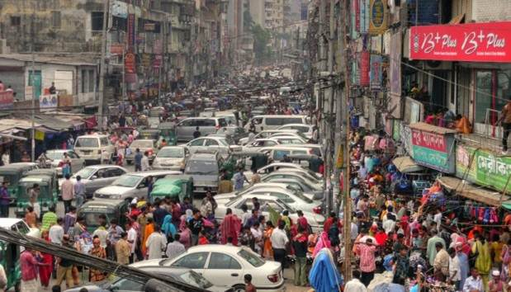
Crowded Cities
Many Asian cities have huge populations. In fact, 16 of the 20 most populated urban areas in the world are in Southern and Eastern Asia.
In Chinese cities like Beijing and Shanghai, the population can exceed almost 6,000 people per square mile.
Much of Japan’s population is crowded into cities.
Tokyo is the most crowded urban area in the world, and land in Tokyo is precious and very expensive.

Slide 5
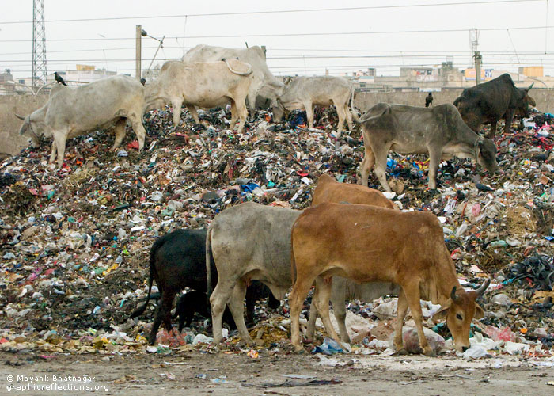
Crowded Cities
In India, information technology and telecommunications are growing industries, providing many employment opportunities in cities like Mumbai and Kolkata.
Unfortunately, many people living in Asian cities are very poor and live in extremely crowded, unsanitary conditions.

Slide 6
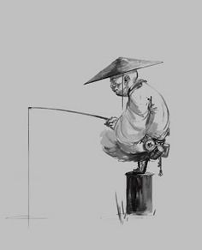
Living off the Land
Many Asian countries have long coastlines. Taking advantage of the natural resources of ocean water and deep harbors, ship repair and shipbuilding are important industries.
The world’s leading fishing country is Japan, with China in 2nd place.
Some of the oldest rainforests are in Asia mainly in Indonesia, Malaysia, Thailand, Cambodia, and Laos.
Few people live in the rainforest, and deforestation is making them disappear.

Slide 7
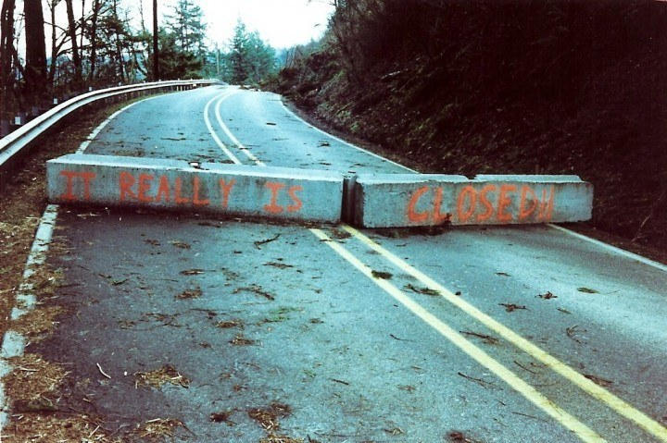
Getting Around
Across Asia, transportation systems are largely undeveloped.
Most railroads don’t cross international boundaries, road systems are not well developed, and links between countries are often closed because of disagreements between countries.
Most Asian international travel is by sea or by air.

Slide 8
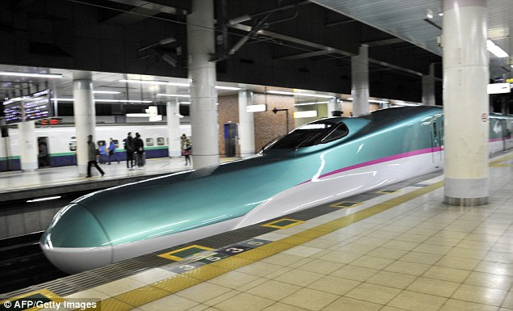
Getting Around
How you travel in Asia depends upon where you live. Walking is a common form of transportation in rural areas, while people in cities use cars and public transportation.
The Japanese have a high-speed rail system (The Bullet Train)where trains travel up to 199 mph. The safe and comfortable rail system transports millions of passengers per year.
Commuters rely on this long-distance rail system to get from city to city in a short amount of time.

Slide 9
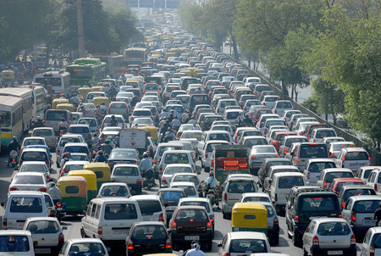
Getting Around
Because of the thriving economy, many people in Beijing, China can afford cars, but the roads are extremely congested (crowded).
Public bus and subway systems are available to ease the traffic problem, and people still use bicycles and walk.

Slide 10
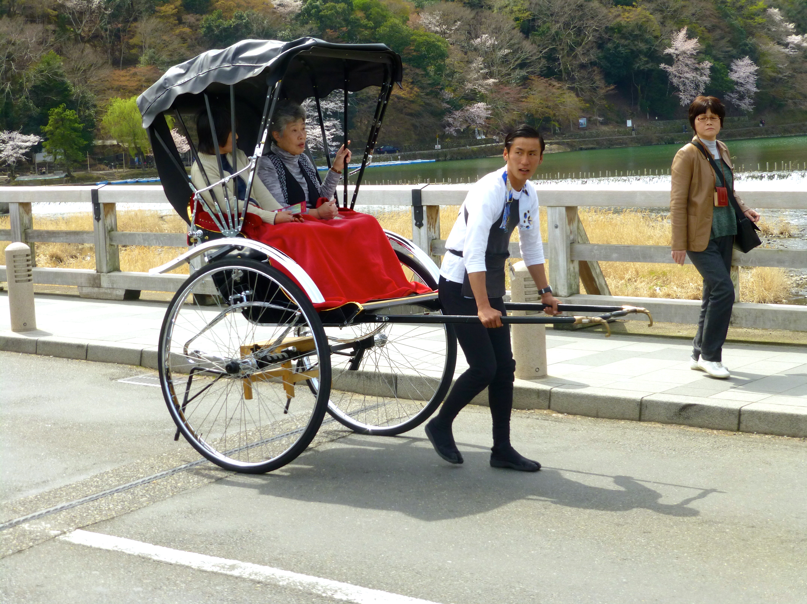
Getting Around
People in India use cars, buses, and bicycles to get around, but many roads in the cities are highly congested.
Rickshaws (two-wheeled carts carrying one passenger that is pulled by person) are still used in Indian cities.

