Slide 1
Comparing
African
Economies
South Africa & Nigeria

Slide 2
Standards
SS7E1 The student will analyze different economic systems.
a. Compare how traditional, command, and market economies answer the economic questions of (1) what to produce, (2) how to produce, and (3) for whom to produce.
b. Explain how most countries have a mixed economy located on a continuum between pure market and pure command.
c. Compare and contrast the economic systems in South Africa and Nigeria.

Slide 3
Comparing
African
Economies
South Africa & Nigeria

Slide 4
Let’s Review
Economic Systems
Do you remember the three questions that every country must answer when developing its economic plan?
What goods/services will be produced?
How will goods/services be produced?
Who will consume the goods/services?
The way a country answers these questions determines what kind of economic system it will have:
Traditional Command Market

Slide 5
Traditional Economy
All economic decisions are based on customs, traditions, & beliefs of the past.
People will make what they always made & do the same things their parents did.
The exchange of goods is done through bartering.
Bartering = trading without using money
Some examples: villages in Africa & South America, the Inuit in Canada, Aborigines in Australia

Slide 6
Command Economy
All economic decisions are made by the Government.
The government owns most of the property, sets the prices of goods, determines the wages of workers, plans what will be made…everything.
This system has not been very successful. More and more countries are abandoning it.
This system is very harsh to live under; because of this, there are no PURE command countries in the world today.
Some countries are close: Cuba, former Soviet Union, North Korea, former East Germany, etc.
All of these countries have the same type of government: Communist! The government is in control of everything.

Slide 7
Market Economy
Economic decisions are made based on the changes in prices that occur as buyers & sellers interact in the market place.
The government has no control over the economy; private citizens answer all economic questions.
In a truly free market economy, the government would not be involved at all. Scary…
There would be no laws to make sure goods/services were safe. *Food! Medicine!
There would be no laws to protect workers from unfair bosses.
Because of this, there are no PURE market economies, but some countries are closer than others.
Some Examples: US, UK, Australia, etc.

Slide 8
Hmmm…
Since there are no countries that are purely command or purely market, what does that make them?
Most democratic countries have some characteristics of both systems, so we keep it simple and call them: MIXED
Of course, most countries’ economies are closer to one type of system than another.

Slide 9
Let’s Review
Factors of Production
There are 4 factors of production that influence economic growth within a country:
Natural Resources available
Investment in Human Capital
Investment in Capital Goods
Entrepreneurship
The presence or absence of these 4 factors determine the country’s Gross Domestic Product (GDP) for the year.

Slide 10
Gross Domestic
Product
GDP is the total value of all the goods and services produced in that country in one year.
It measures how rich or poor a country is.
It shows if the country’s economy is getting better or worse.
Raising the GDP of a country can improve the country’s standard of living.

Slide 11
Natural Resources
“Gifts of Nature”
Natural resources are important to countries because without them, countries must import the resources they need (can be costly).
A country is better off if it can use its own resources to supply the needs of its people.
If a country has many natural resources, it can trade/sell them with other countries.

Slide 12
Capital Goods
To increase GDP, countries must invest in capital goods:
All of the factories, machines, technologies, buildings, and property needed by businesses to operate.
If a business is to be successful, it cannot let its equipment break down or have its buildings fall apart.
New technology can help a business produce more goods for a cheaper price.

Slide 13
Human Capital
To increase GDP, countries must invest in human capital.
Human capital is the knowledge and skills that make it possible for workers to earn a living producing goods and services.
This includes education, training, skills, and healthcare of the workers in a business or country.

Slide 14
Entrepreneurship
People who provide the money to start and operate a business are called entrepreneurs.
These people risk their own money and time because they believe their business ideas will make a profit.
Entrepreneurs must organize their businesses well for them to be successful .
They bring together natural, human, and capital resources to produce foods or services to be provided by their businesses.

Slide 15
Specialization
Not every country can produce all of the goods and services it needs.
Countries specialize in producing those goods and services they can provide best and most efficiently.
They look for others who may need these goods and services so they can sell their products.
The money earned by such sales then allows the purchase of goods and services the first county is unable to produce.
In international trade, no country can be completely self-sufficient (produce all the goods and services it needs).
Specialization creates a way to build a profitable economy and to earn money to buy items that cannot be made locally.

Slide 16
South Africa’s
Economy

Slide 17
Economic System
South Africa has a technologically advanced mixed economic system.
It’s actually closer to a market system than it is to a command one; however, there is some government regulation and control among industries.
South Africa is economically strong.
It is one of the strongest economies in Africa.

Slide 18
GDP
South Africa’s GDP is $592 billion (US dollars).
It is ranked 26th in the world.
The GDP per capita (value of goods and services produced per person) is $11,600.

Slide 19
Natural Resources
What are South Africa’s major natural resources?
gold, chromium, antimony, coal, iron ore, manganese, nickel, phosphates, tin, rare earth elements, uranium, gem diamonds, platinum, copper, vanadium, salt, natural gas
South Africa has rich deposits of gold, diamonds, platinum, and other metals.
It is world’s largest producer of platinum, gold, and chromium.

Slide 20
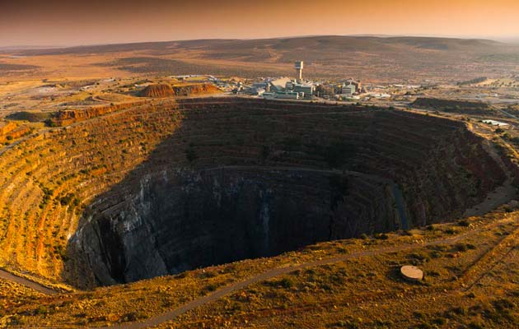
Finsch Diamond Mine, South Africa

Slide 21
Land Use
What percentage of the land is arable (capable of being farmed)?
9.9%
What are the major agricultural products?
corn, wheat, sugarcane, fruits, vegetables, beef, poultry, mutton, wool, dairy products

Slide 22
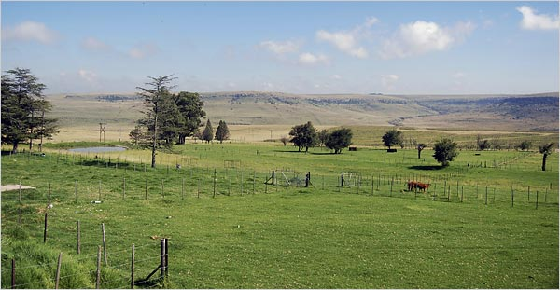
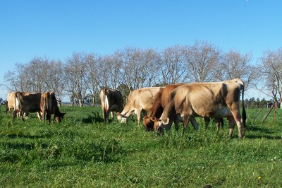
Cattle Ranch

Slide 23
Industries
What’s produced in South Africa’s factories?
Mining materials, automobile assembly, metalworking, machinery, textiles, iron and steel, chemicals, fertilizer, foodstuffs, commercial ship repair
The service industry accounts for 65% of South Africa’s economy – areas such as insurance, banking, retail, and tourism.

Slide 24
Specialization
South Africa’s chief exports include:
gold, diamonds, platinum, other metals and minerals, machinery and equipment
South Africa has specialized in the development of its mineral wealth and has a thriving metals industry.

Slide 25
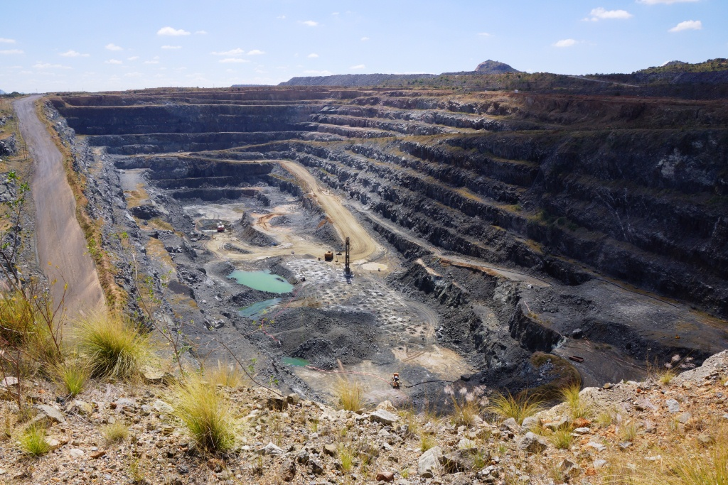
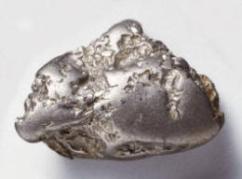
Platinum Mining in South Africa

Slide 26
Literacy Rate
What percentage of the population over the age of 15 can read and write?
93%
How long are students expected to stay in school?
Most students drop out of school when they are 13 years old.

Slide 27
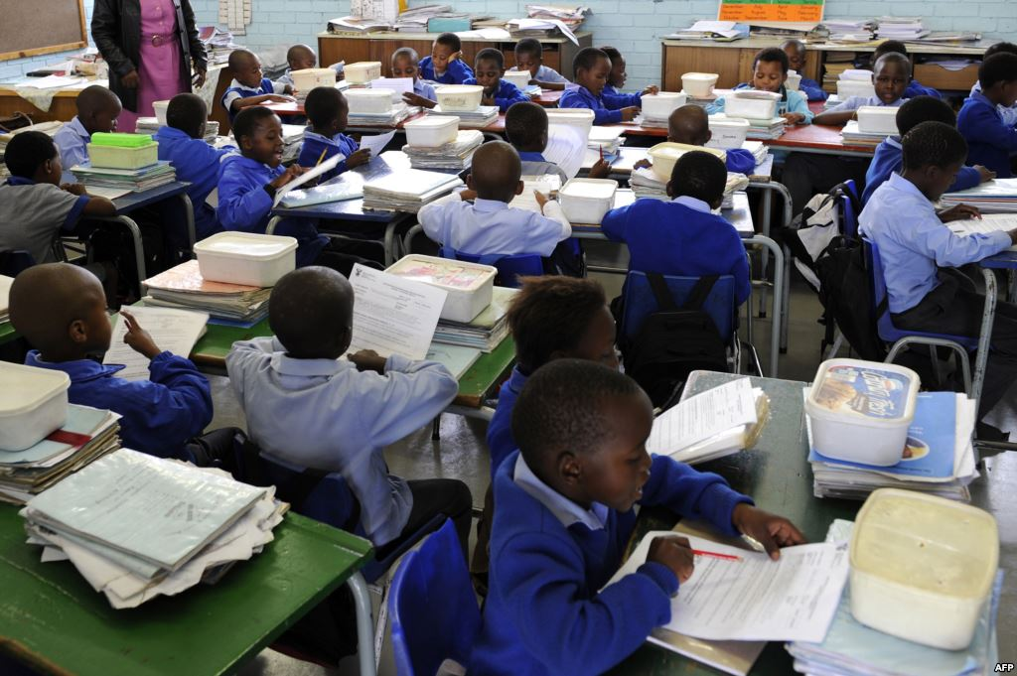
School Equality?

Slide 29
Unemployment Rate
What percentage of people do not have jobs?
22.7% of South Africa’s workforce is unemployed.
What percentage of people live in poverty?
31.3% of South Africa’s population live below the poverty line and cannot meet basic needs.

Slide 30
Nigeria’s
Economy

Slide 31
Economic System
Like all countries with democracies, Nigeria has a mixed economic system.
However, because of a long period of military dictatorship, Nigeria’s poorly organized economy is struggling to move away from a command system.
Nigeria would like to become a strong leader in the world’s oil market, but poor organization and corruption are obstacles that the country must correct and overcome.

Slide 32
GDP
Nigeria’s GDP is $455.5 billion (US dollars).
It is ranked 31st in the world.
The GDP per capita (value of goods and services produced per person) is $2,800.

Slide 33
Natural Resources
What are Nigeria’s major natural resources?
natural gas, petroleum, tin, iron ore, coal, limestone, niobium, lead, zinc, & arable land
Nigeria has rich oil deposits.
The country's petroleum sector is the focus of Nigeria’s economy.
The United States gets almost 17% of its imported oil from Nigeria.

Slide 34
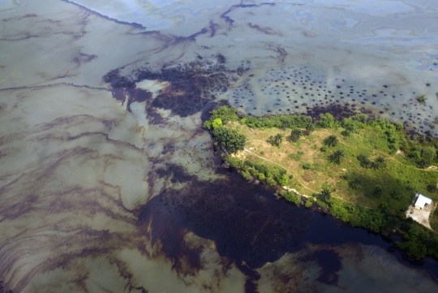
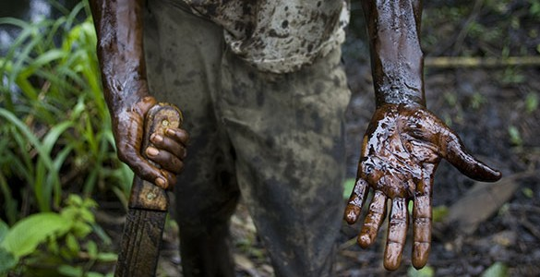
Nigerian Oil Spill, 2011

Slide 35
Land Use
What percentage of the land is arable (capable of being farmed)?
38.97%
What are the major agricultural products?
cocoa, peanuts, cotton, palm oil, corn, rice, sorghum, millet, cassava (tapioca), yams, rubber, cattle, sheep, goats, pigs, timber, fish

Slide 36
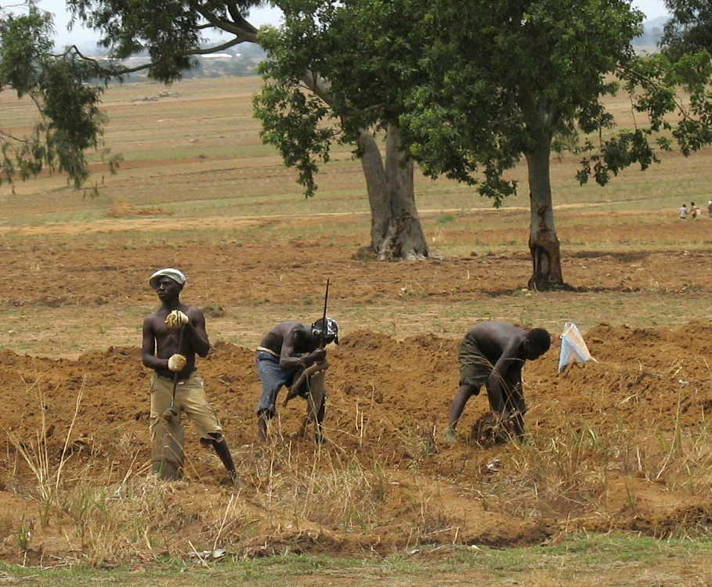
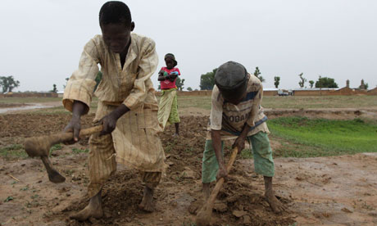
Currency e

Slide 37
Industries
What’s produced in Nigeria’s factories?
crude oil, coal, tin, columbite, rubber products, wood, hides and skins, textiles, cement and other construction materials, food products, footwear, chemicals, fertilizer, printing, ceramics, steel
Agriculture accounts for 70% of Nigeria’s economy.

Slide 38
Specialization
Nigeria’s chief exports include:
petroleum and petroleum products (95%), cocoa, & rubber
Nigeria specializes in exporting oil.
Unfortunately, the emphasis on oil production has left other parts of Nigeria’s economy disorganized.
Nigeria has to import food to feed its growing population.

Slide 39
Literacy Rate
What percentage of the population over the age of 15 can read and write?
Males – 72.1%
Females – 50.4%
How long are students expected to stay in school?
Males – 10 years old
Females – 8 years old

Slide 40
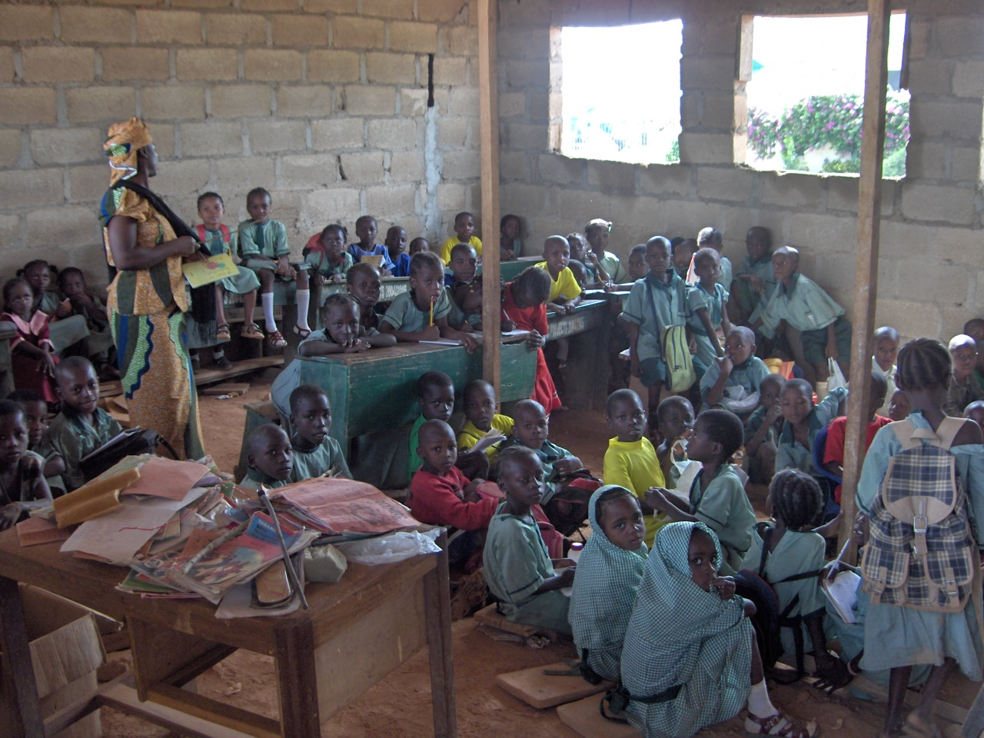
Nigerian School

Slide 41
Unemployment Rate
What percentage of people do not have jobs?
23.9% of Nigeria’s workforce is unemployed.
What percentage of people live in poverty?
70% of Nigeria’s population cannot meet basic needs.

Slide 42
Currency Exchange
Currency exchange is the price of one country’s currency compared to another.
1 US dollar = 10.23 South African rand
1 US dollar = 158.4 Nigerian naira
1 South African rand = 15.5 Nigerian naira
What does this mean?
South Africa’s economy is stronger than Nigeria’s, but the US’s economy is much stronger than both.

Slide 43
Credits:
Facts & Statistics were found via CIA World Factbook in November 2013. All photos were found via Creative Commons and labeled for reuse.
Fonts:
Backgrounds & Graphics:

