Slide 1
The Integumentary System (the skin)
Chapter 13.4

Slide 2
Functions of the Skin
Temperature Regulation
Sweat glands
Sensation
Root hair plexuses
Pain and heat/cold receptors
Blood Reservoir
Shunts more blood into the circulation when needed.
Excretion
Vitamin D Production
Protection for the Body

Slide 3
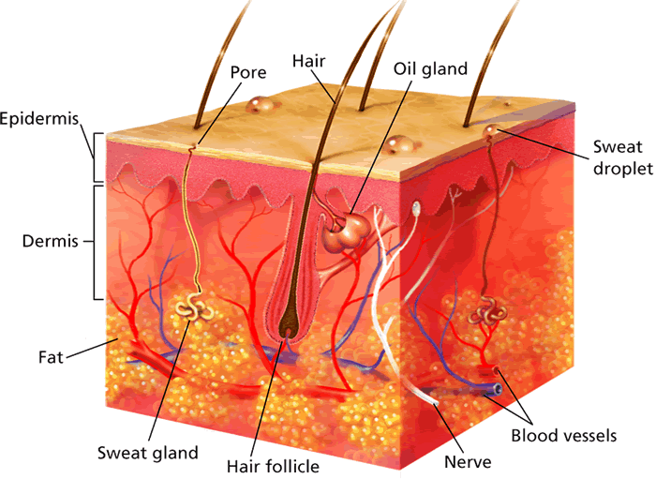
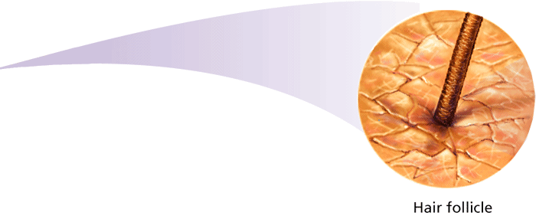
The Epidermis
- The Skin
The skin is organized into two main layers: the epidermis and the dermis.

Slide 4
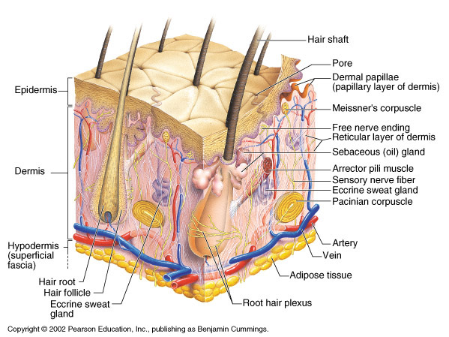

Slide 5
Epidermis
Outermost layer.
Composed mostly of keratin
Contains 4 distinct cell types and 4 to 5 distinct layers.
Outer layer is dead cells
Skin color—determined by melanin (pigment), carotene, and hemoglobin.
Freckles & moles

Slide 6
The Dermis
Made mostly of connective tissue.
The hide of the human body.
Contains the hair follicles, sweat glands, oil glands, lymphatic vessels, and many sensory receptors.
Layer of fat under the dermis

