Slide 1
The Nervous System

Slide 2
Functions
Receive Information about the things happening in and out of your body
Respond to Information (stimulus and response)
Maintains Homeostasis

Slide 3
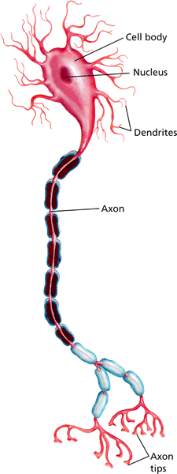
The Neuron
- How the Nervous System Works
A neuron has a large cell body that contains the nucleus, threadlike extensions called dendrites, and an axon.

Slide 4


- How the Nervous System Works
Previewing Visuals
Before you read, preview Figure 3. Then write two questions you have about the diagram in a graphic organizer like the one below. As you read, answer your questions.
The Path of a Nerve Impulse
Q. What is a sensory neuron?
A. A neuron that picks up stimuli from the internal or external environment and converts each stimulus into a nerve impulse
Q. What does an interneuron do?
It carries nerve impulses from one neuron to another.
What does a motor neuron do?
A. It carries nerve impulses to the muscle or gland for the response.

Slide 5
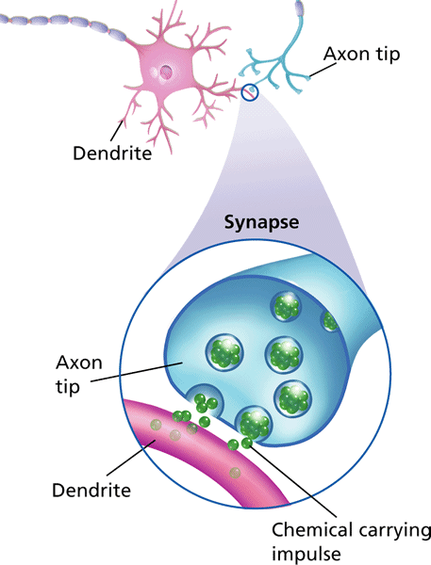
How a Nerve Impulse Travels
- How the Nervous System Works
An impulse moves from the
dendrites, through the axon to the axon tips.
For a nerve impulse to be carried along at a synapse, it must cross the gap between the axon and the next structure. The axon tips release chemicals that carry the impulse across the gap.

Slide 6
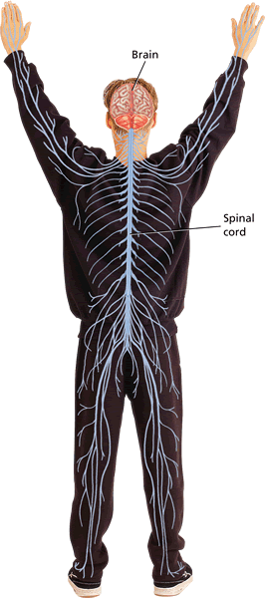
Central Nervous System
- Divisions of the Nervous System
The central nervous system is the control center of the body. It includes the brain and spinal cord.

Slide 7
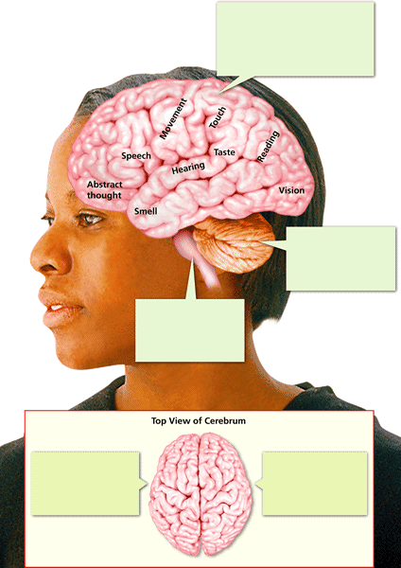





The Brain
- Divisions of the Nervous System
There are three main regions of the brain that receive and process information. These are the cerebrum, the cerebellum, and the brain stem.

Slide 8
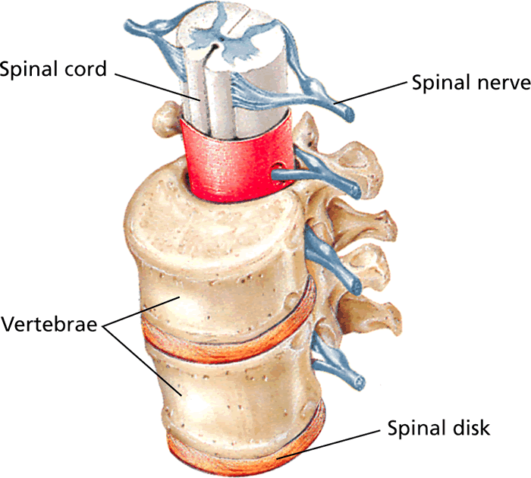
Peripheral Nervous System
- Divisions of the Nervous System
The peripheral nervous system consists of a network of nerves that branch out from the central nervous system and connect it to the rest of the body. The peripheral nervous system is involved in both involuntary and voluntary actions.

Slide 9
Building Vocabulary
- Divisions of the Nervous System
After you read the section, reread the paragraphs that contain definitions of Key Terms. Use the information you have learned to write a definition of each Key Term in your own words.
Key Terms:
Key Terms:
Key Terms:
Examples:
Examples:
Examples:
central nervous system
The central nervous system is the division of the nervous system made up of the brain and spinal cord.
cerebrum
autonomic nervous system
The cerebrum is the division of the nervous system made up of the brain and spinal cord.
Nerves of the autonomic nervous system control involuntary actions.
peripheral nervous system
The peripheral nervous system is the division of the nervous system made up of all nerves outside the central nervous system.
cerebellum
The cerebellum coordinates the actions of your muscles and helps you to keep your balance.
reflex
The blink, which is a reflex, is a response that happens automatically.
brain stem
The brain stem, which lies between the cerebellum and spinal cord, controls your body’s involuntary actions—those that occur automatically.
concussion
A concussion is a bruiselike injury of the brain.
brain
The brain is the part of the central nervous system that is located in the skull and that controls most functions in the body.
somatic nervous system
The nerves of the somatic nervous system control voluntary actions such as using a fork or tying your shoes.
spinal cord
The spinal cord is the thick column of nervous tissue that links the brain to most of the nerves in the peripheral nervous system.

Slide 10
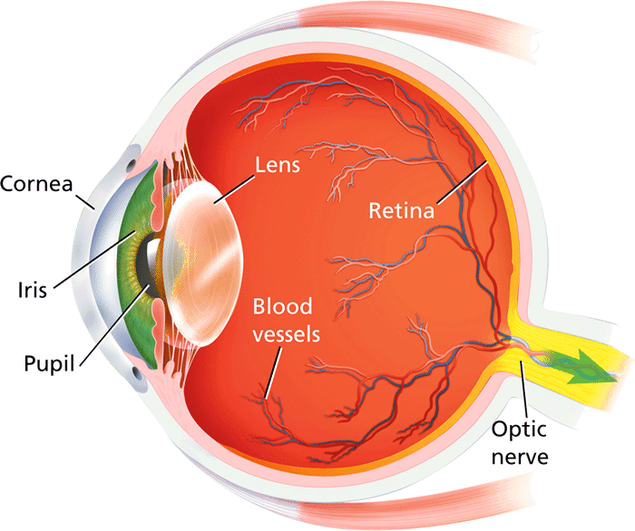
Vision
- The Senses
Your eyes respond to the stimulus of light. They convert that stimulus into impulses that your brain interprets, enabling you to see.

Slide 11
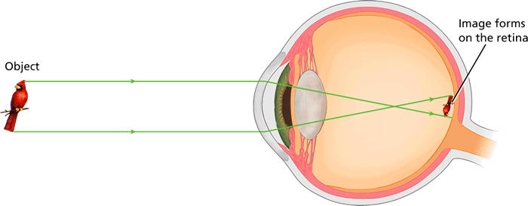
Vision
- The Senses
Light coming from an object enters your eye and is focused by the lens. The light produces an upside-down image on your retina. Receptors in your retina then send impulses to your cerebrum, which turns the image right-side up.

Slide 12
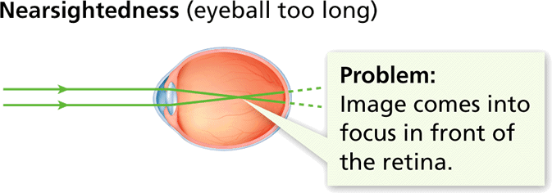
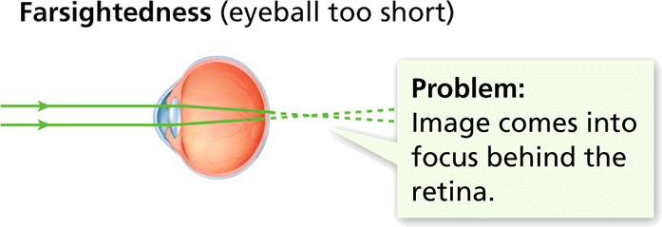
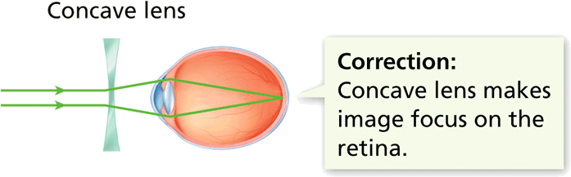
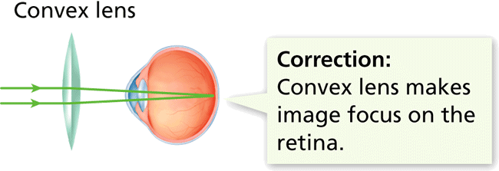
Vision
- The Senses
If the lens of the eye does not focus light properly on the retina, vision problems result.

Slide 13
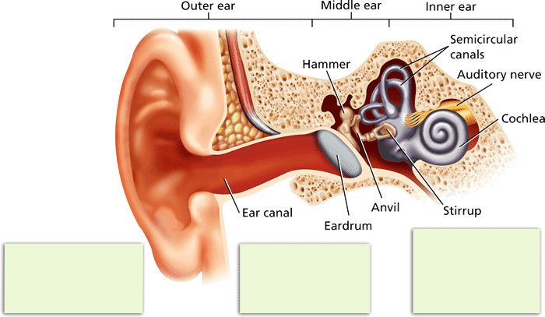



Hearing and Balance
- The Senses
Your ears are the sense organs that respond to the stimulus of sound. Ears convert the sound to nerve impulses that your brain interprets.

Slide 14
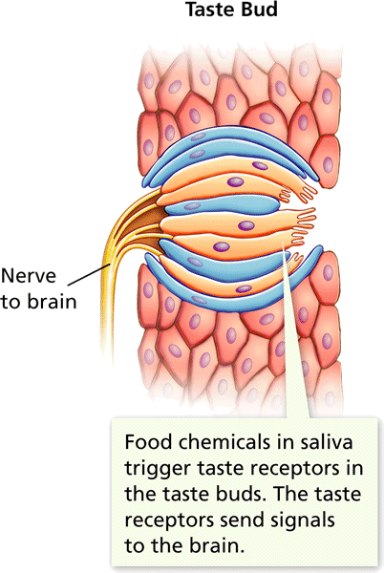
Smell and Taste
- The Senses
The senses of smell and taste work closely together. Both depend on chemicals in food or in the air. The chemicals trigger responses in receptors in the nose and mouth.

